Slide 1
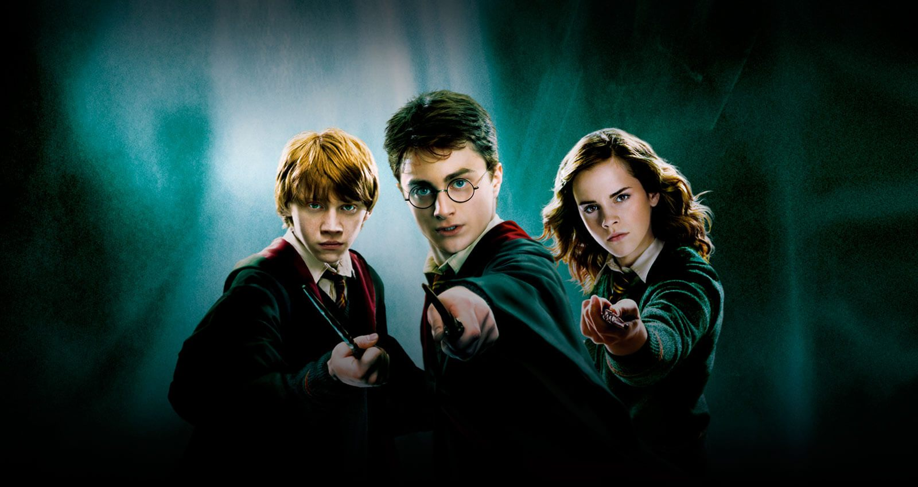
J.K. Rowling’s Harry Potter A General Discussion

Slide 2
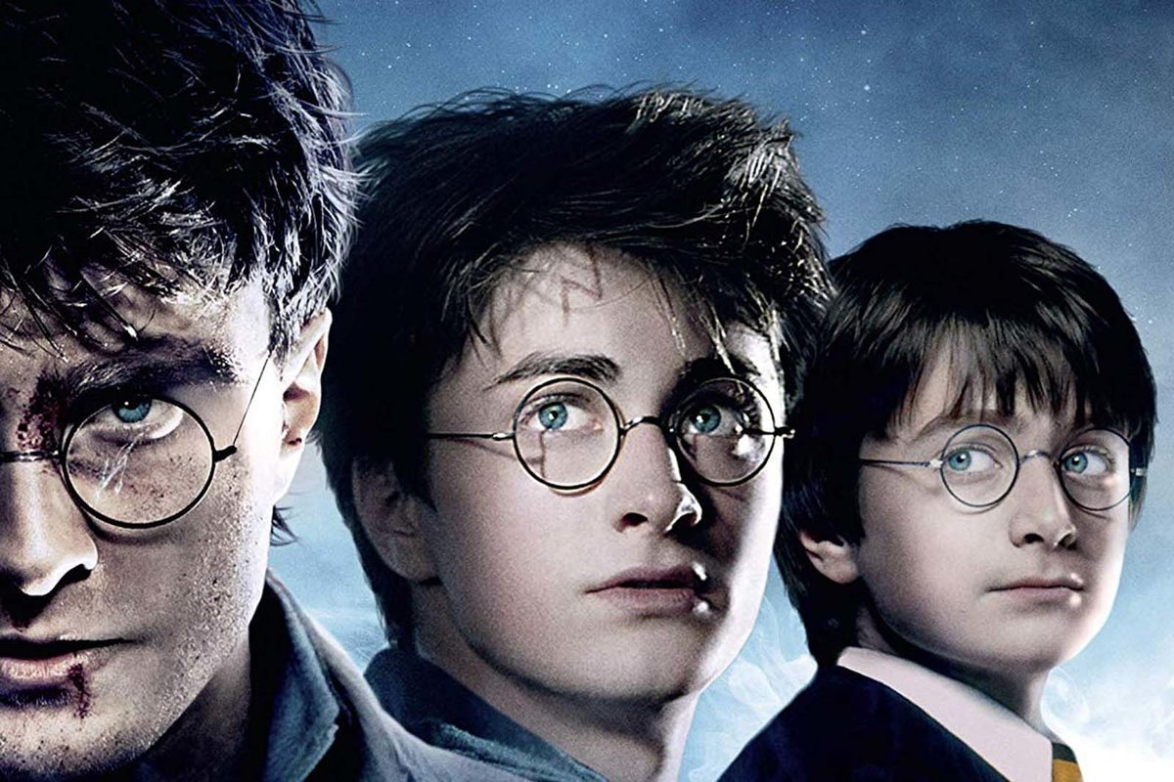
How much of Harry Potter have you absorbed? (Some or all of the books? Some or all of the Films? The Cursed Child? Did you wait all night for a book launch? Do you dress up as a Harry Potter character?
How were you introduced to Harry Potter?
Were you allowed to read Harry Potter when you were growing up?
What effect did it have on you?
If you weren’t allowed to read Harry Potter, why not?
What’s your favourite moment?
Who is your favourite character and why?
What House were you put into in Pottermore?
What Fantasy Theory can we apply to the Harry Potter books?
Is JK Rowling’s writing beyond criticism?

Slide 3
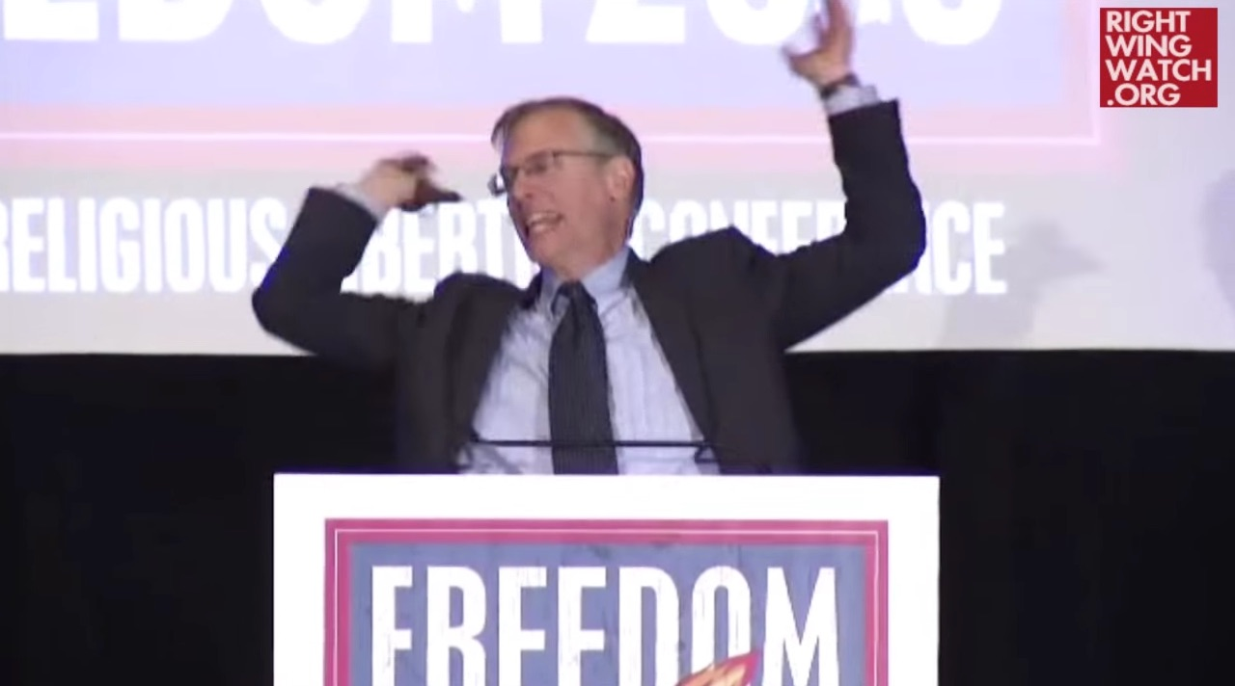
Pastor: Parents should drown kids instead of letting them read Harry Potter
http://www.pinknews.co.uk/2015/11/09/pastor-parents-should-drown-kids-instead-of-letting-them-read-harry-potter/?utm_source=PNFB&utm_medium=socialFB&utm_campaign=PNFacebook

Slide 4
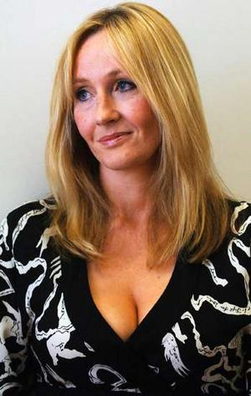
J.K. Rowling
Mother diagnosed with MS when she was a teenager.
Worked for Amnesty International and as a language assistant in Portugal.
Wrote a great deal of her first Harry Potter book while bringing up her daughter in a one parent family.

Slide 5
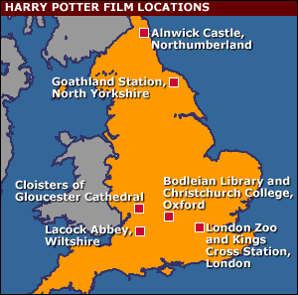
Harry Potter and the Philosopher’s Stone: a novel of English Tradition
‘Rowling presents two Englands, mundane and magical, divided not by social classes, but by the distinction between the "perfectly normal" (mean and selfish) and the adherents of sorcery.’ - Bloom

Slide 6
Jane Sullivan on the “Bad Writing” Debate
Jane Sullivan
‘We can express disapproval of all those adults reading Harry Potter in trains and trams; we can snort in derision at those who already want to declare the books as classics of children's literature; we can praise other writers for children we think are much better; we can launch magisterial attacks on J.K. Rowling's style (or lack of it), her derivative magical world, her dire need of an editor. All these things have been done, over and over. But what we cannot do is turn ourselves back into children and see her books through their eyes.’
https://www.theguardian.com/books/booksblog/2007/jul/17/harrypottersbigconisthep
https://www.reddit.com/r/changemyview/comments/1hafxx/i_believe_that_the_harry_potter_series_is_lazy/

Slide 7
‘In my own case, some of the most wonderful memories I have of childhood reading are not of the great children's classics (though I read and enjoyed those too) but of seven books by a writer much, much worse than J.K. Rowling. She was politically incorrect, her prose was flat and twee and cliche-ridden and her characters lived in a jolly never-never land where you could go off into the countryside for hours or days at a time with no parental supervision and only a few buns and gallons of ginger beer to keep you going.’
I'm talking about Enid Blyton, of course - a writer Byatt briefly refers to because children once invested her "pasteboard kids with their own childish desires and hopes". Yes, but what desires and hopes, and what pasteboard!’
A.S. Byatt

Slide 8
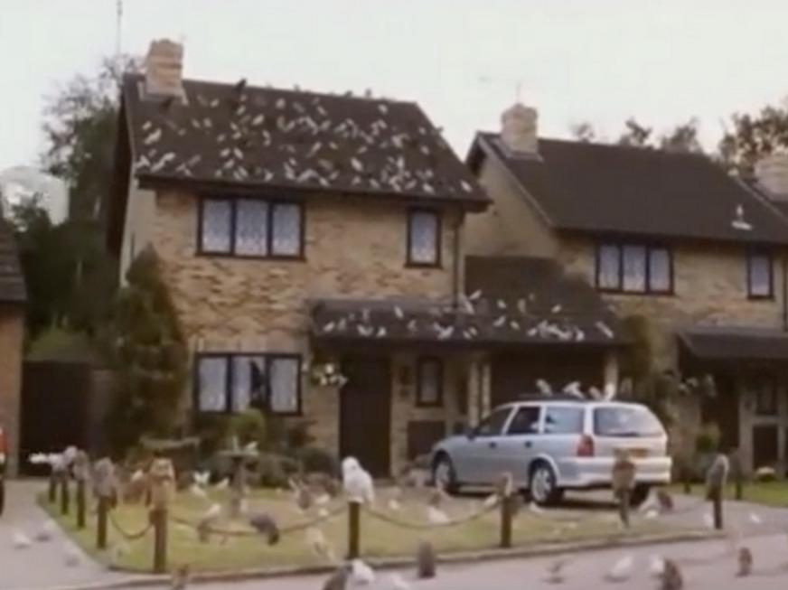
‘Her prose style, heavy on cliche, makes no demands upon her readers. In an arbitrarily chosen single page--page 4--of the first Harry Potter book, I count seven cliches, all of the "stretch his legs" variety.’
Mr. and Mrs. Dursley, of number four, Privet Drive, were proud to say that they were perfectly normal, thank you very much. They were the last people you'd expect to be involved in anything strange or mysterious, because they just didn't hold with such nonsense.

Slide 9
A.S. Byatt on Rowling’s “Bad Writing”
‘Ms. Rowling's magic world has no place for the numinous. It is written for people whose imaginative lives are confined to TV cartoons, and the exaggerated (more exciting, not threatening) mirror-worlds of soaps, reality TV and celebrity gossip. Its values, and everything in it, are, as Gatsby said of his own world when the light had gone out of his dream, "only personal." Nobody is trying to save or destroy anything beyond Harry Potter and his friends and family.’

Slide 10
A.S. Byatt: Harry Potter as a Family Romance
‘Freud described what he called the "family romance," in which a young child, dissatisfied with its ordinary home and parents, invents a fairy tale in which it is secretly of noble origin, and may even be marked out as a hero who is destined to save the world.’

Slide 11
Harry Potter and the Philosopher’s Stone as a Family Romance?
‘In J. K. Rowling's books, Harry is the orphaned child of wizards who were murdered trying to save his life. He lives, for unconvincingly explained reasons, with his aunt and uncle, the truly dreadful Dursleys, who represent, I believe, his real "real" family, and are depicted with a relentless, gleeful, overdone venom. The Dursleys are his true enemy. When he arrives at wizarding school, he moves into a world where everyone, good and evil, recognizes his importance, and tries either to protect or destroy him.’

Slide 12
‘But in the case of the great children's writers of the recent past, there was a compensating seriousness. There was — and is — a real sense of mystery, powerful forces, dangerous creatures in dark forests. […] Ms. Rowling's magic wood has nothing in common with these lost worlds. It is small, and on the school grounds, and dangerous only because she says it is. In this regard, it is magic for our time.’

Slide 13
‘Ms. Rowling, I think, speaks to an adult generation that hasn't known, and doesn't care about, mystery. They are inhabitants of urban jungles, not of the real wild. They don't have the skills to tell ersatz magic from the real thing, for as children they daily invested the ersatz with what imagination they had.’

Slide 14
‘Comfort, I think, is part of the reason. Childhood reading remains potent for most of us. In a recent BBC survey of the top 100 "best reads," more than a quarter were children's books. We like to regress. I know that part of the reason I read Tolkien when I'm ill is that there is an almost total absence of sexuality in his world, which is restful.’

Slide 15
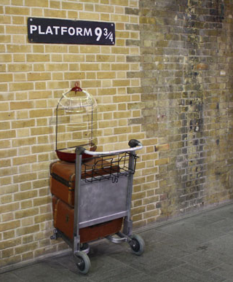
Harry Potter as Portal Fantasy
Possible Portals:
Platform 9 ¾
Leaky Cauldron
Floo Powder
Portkeys

Slide 16
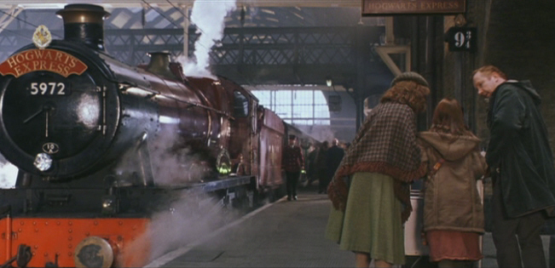

Slide 17
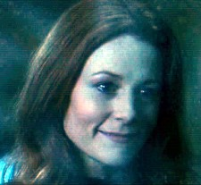
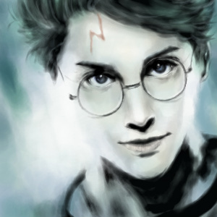
Consider the “voice” of the narrator…

Slide 18
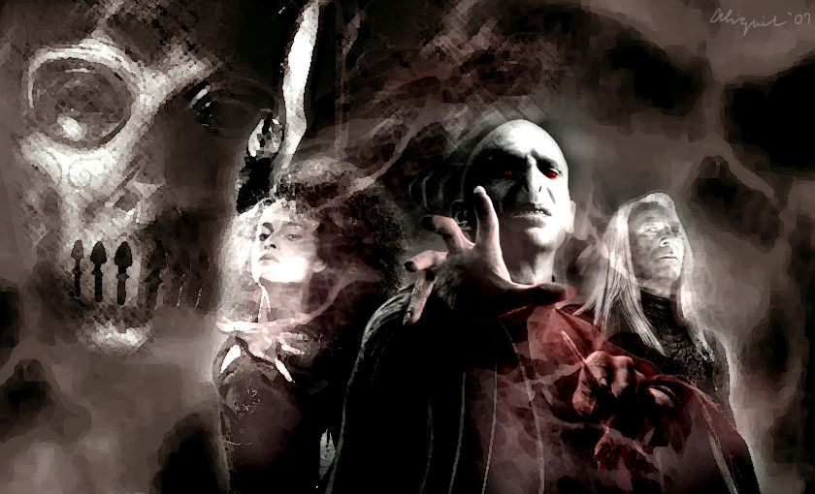
Death
The novel opens with the death of Harry's parents.
What other examples have we seen that might parallel this?
Voldemort's obsession
with conquering death

Slide 19
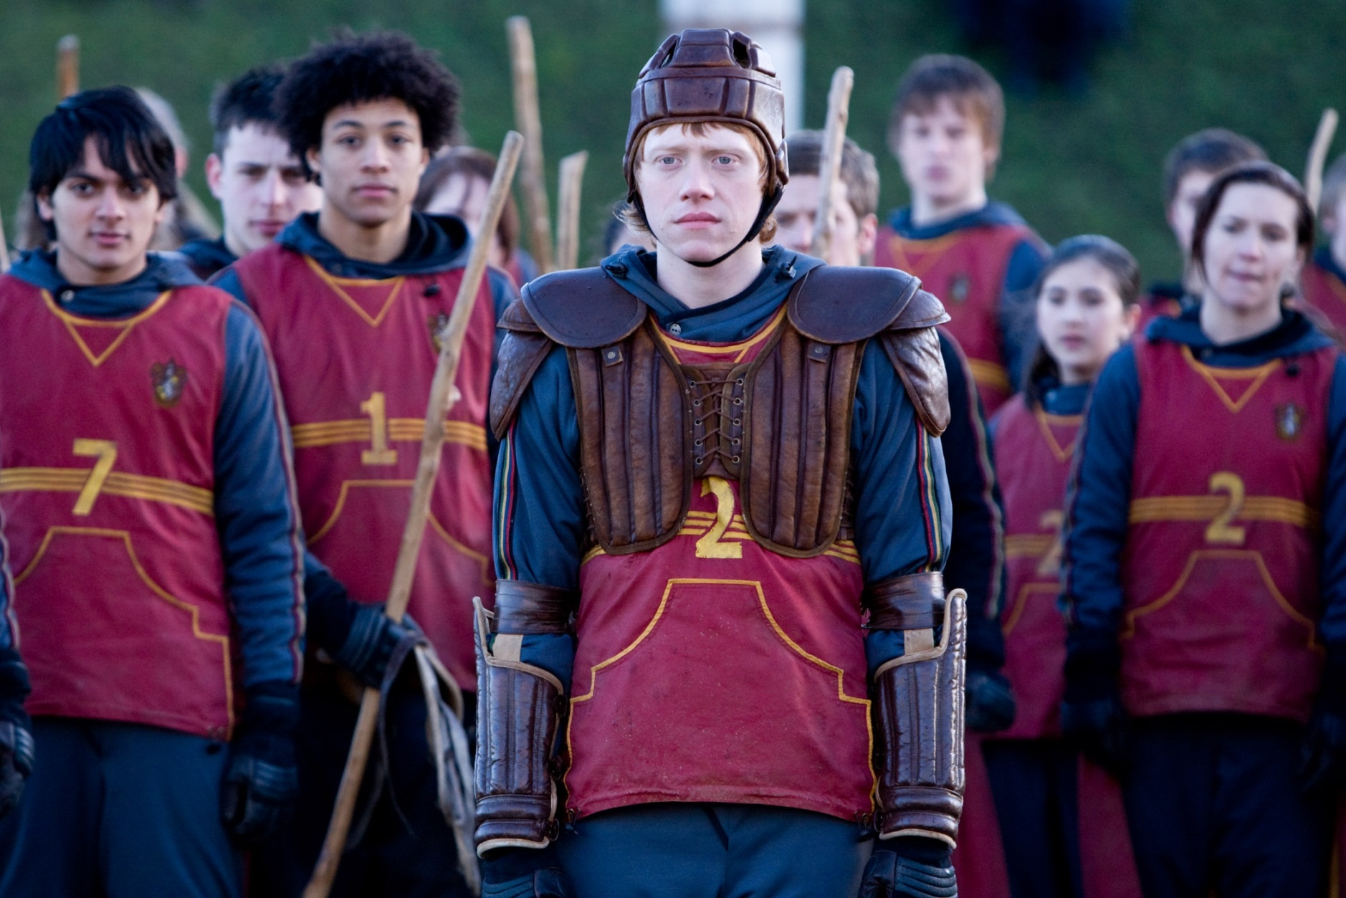
Consider the characters in terms of Gender

Slide 20
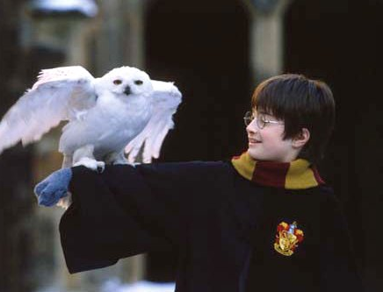
Harry Potter as Hero
How does Harry compare to other heroes of children’s novels, such as Alice, Peter and Lyra?

Slide 21
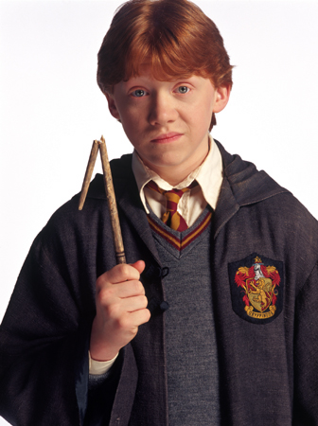
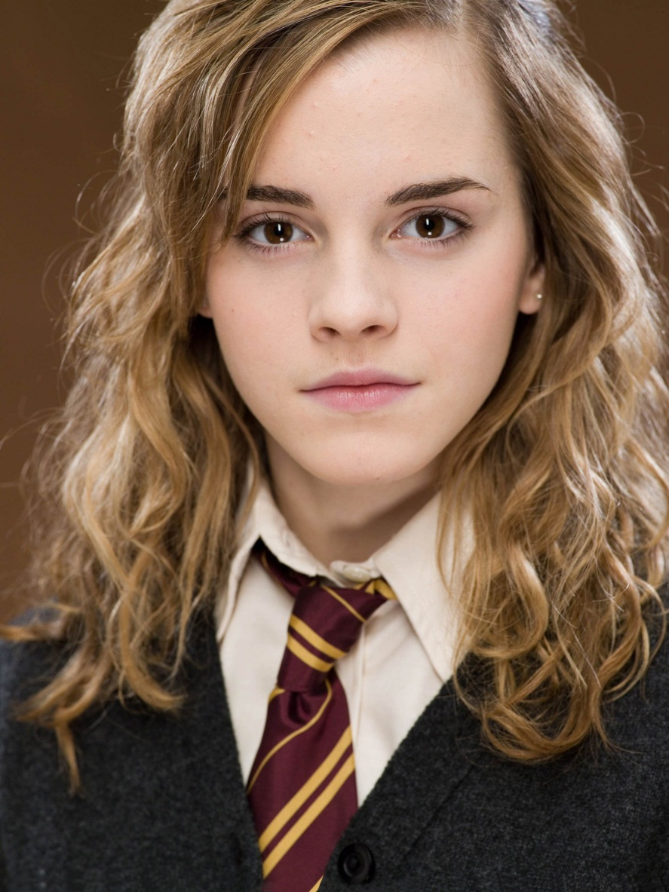
How do readers relate to the other characters?

Slide 22
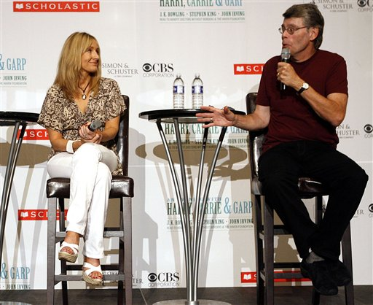
"Rowling's never met an adverb she did not like!“
~Stephen King

Slide 24
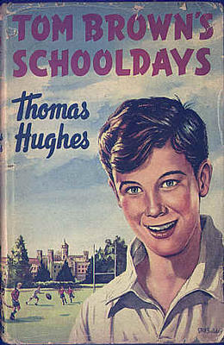
Critical Approaches to Rowling
Generic: (in relation to existing literary genres)
“[Rowling] supplements her use of the vocabulary of magic and the common themes of the boarding school genre with additional levels of meaning that render the books more attractive to adult readers . . .” Pat Pinsent, “The Education of a Wizard” (Whited 27)

Slide 25
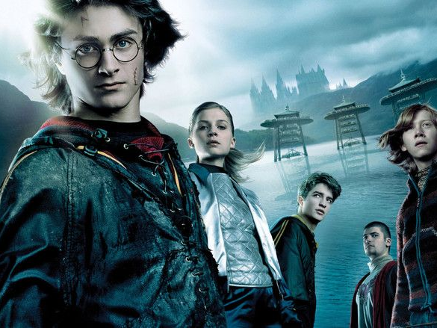
Genre II
The parallels with Tom Brown’s Schooldays by Thomas Hughes (Steege in Whited, 46-560
Games
Friends
Headmaster Thomas Arnold
Flashman the bully
The 19thC ethos of Hogwarts

Slide 26
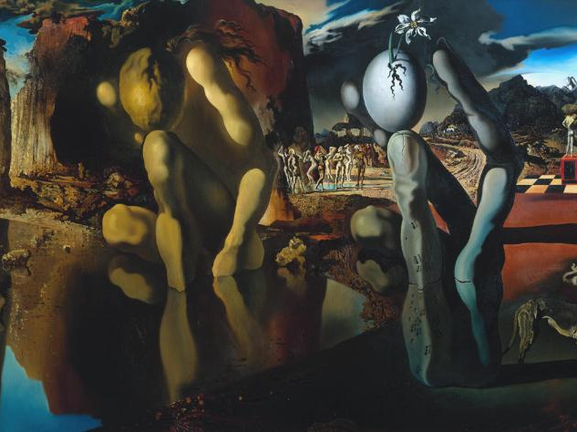
Realism and Fairy Tale Elements
“Developmental\ psychologist Erik Erikson postulated that, at about the age they enter puberty, adolescents enter the psychosocial stage he called identity versus role confusion, \leaving it at about age eighteen to enter the intimacy versus isolation stage. Adolescents’ search for identity includes their lessening dependence on their parents and increasing identification with thei peers . . .” (Grimes in Whited 99)

Slide 27
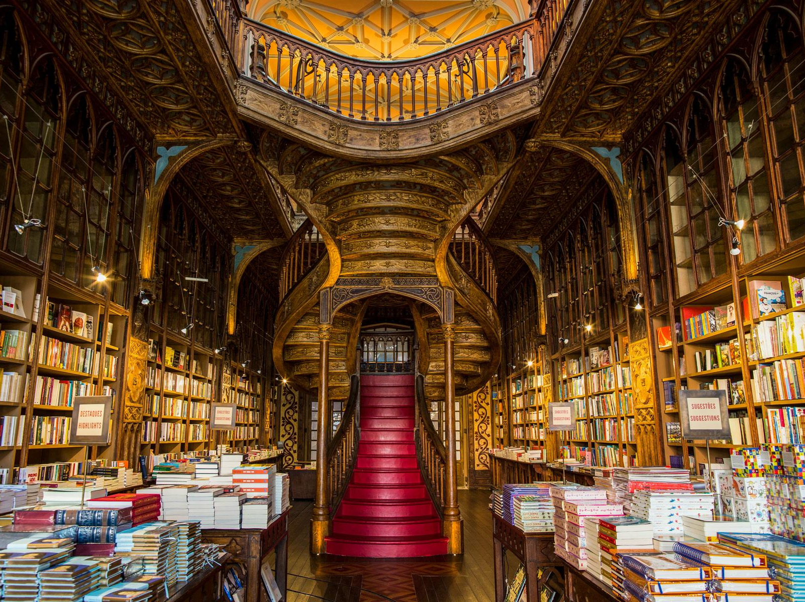
Realism and Fairy Tales II
Fairy tale elements—the orphan; Hogwarts as a place of tests; abandonment; multiple parents; rites of passage into wizardry.
Realism—the imperfections of the hero (and of Hogwarts); humour (the humour’s empathy is another link between characters and readers, “moving from the absurd to the momentous with ease” (Pharr 65), companionship, integrity, depression, betrayal, moral ambiguity of (some) villains.

Slide 28
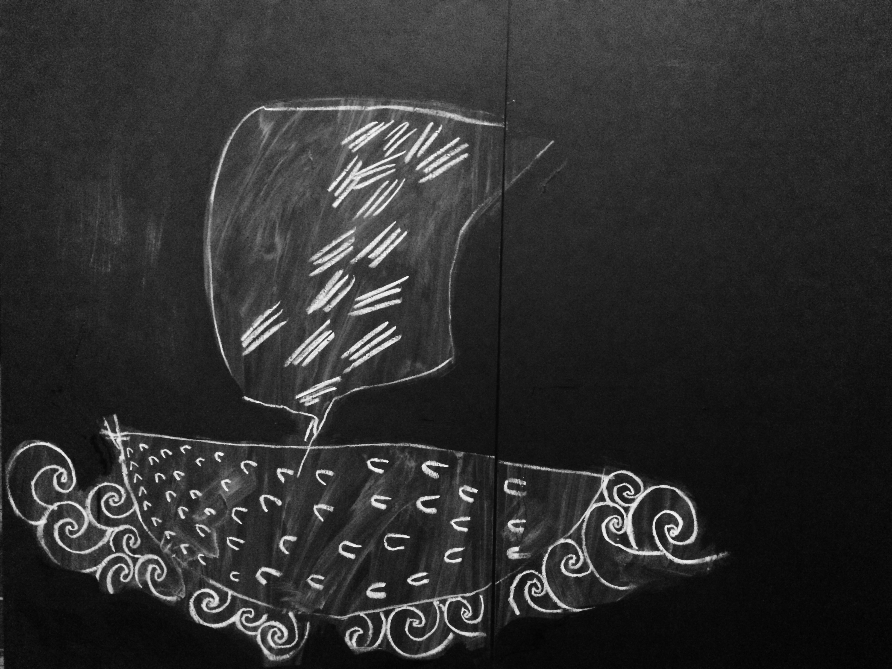
Myths and Moral Tests
Otto Rank, The Myth of the Birth of the Hero (1909)—the classic Freudian analysis of hero myths. Ten basic elements:
The boy is the son of royal or immortal parents
Difficulties precede the conception
Child’s life is threatened by an enemy
Boy is separated from his parents
Boy is exposed in a basket or other receptacle

Slide 29
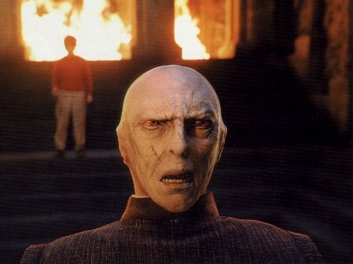
Voldemort as Villain (Intrusion Fantasy)

Slide 30
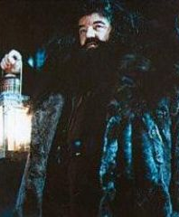
Real and Adopted Parents?
Hagrid
Dumbledore
Professor McGonagall

Slide 31
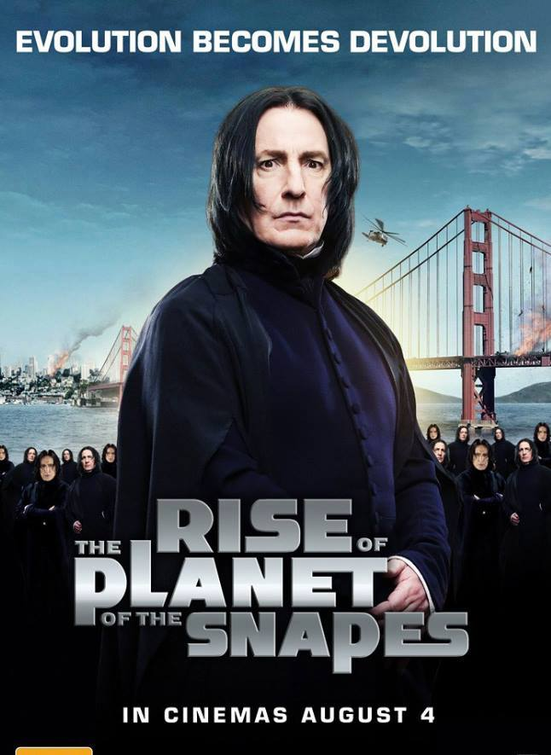
New Harry Potter film?

