Slide 1
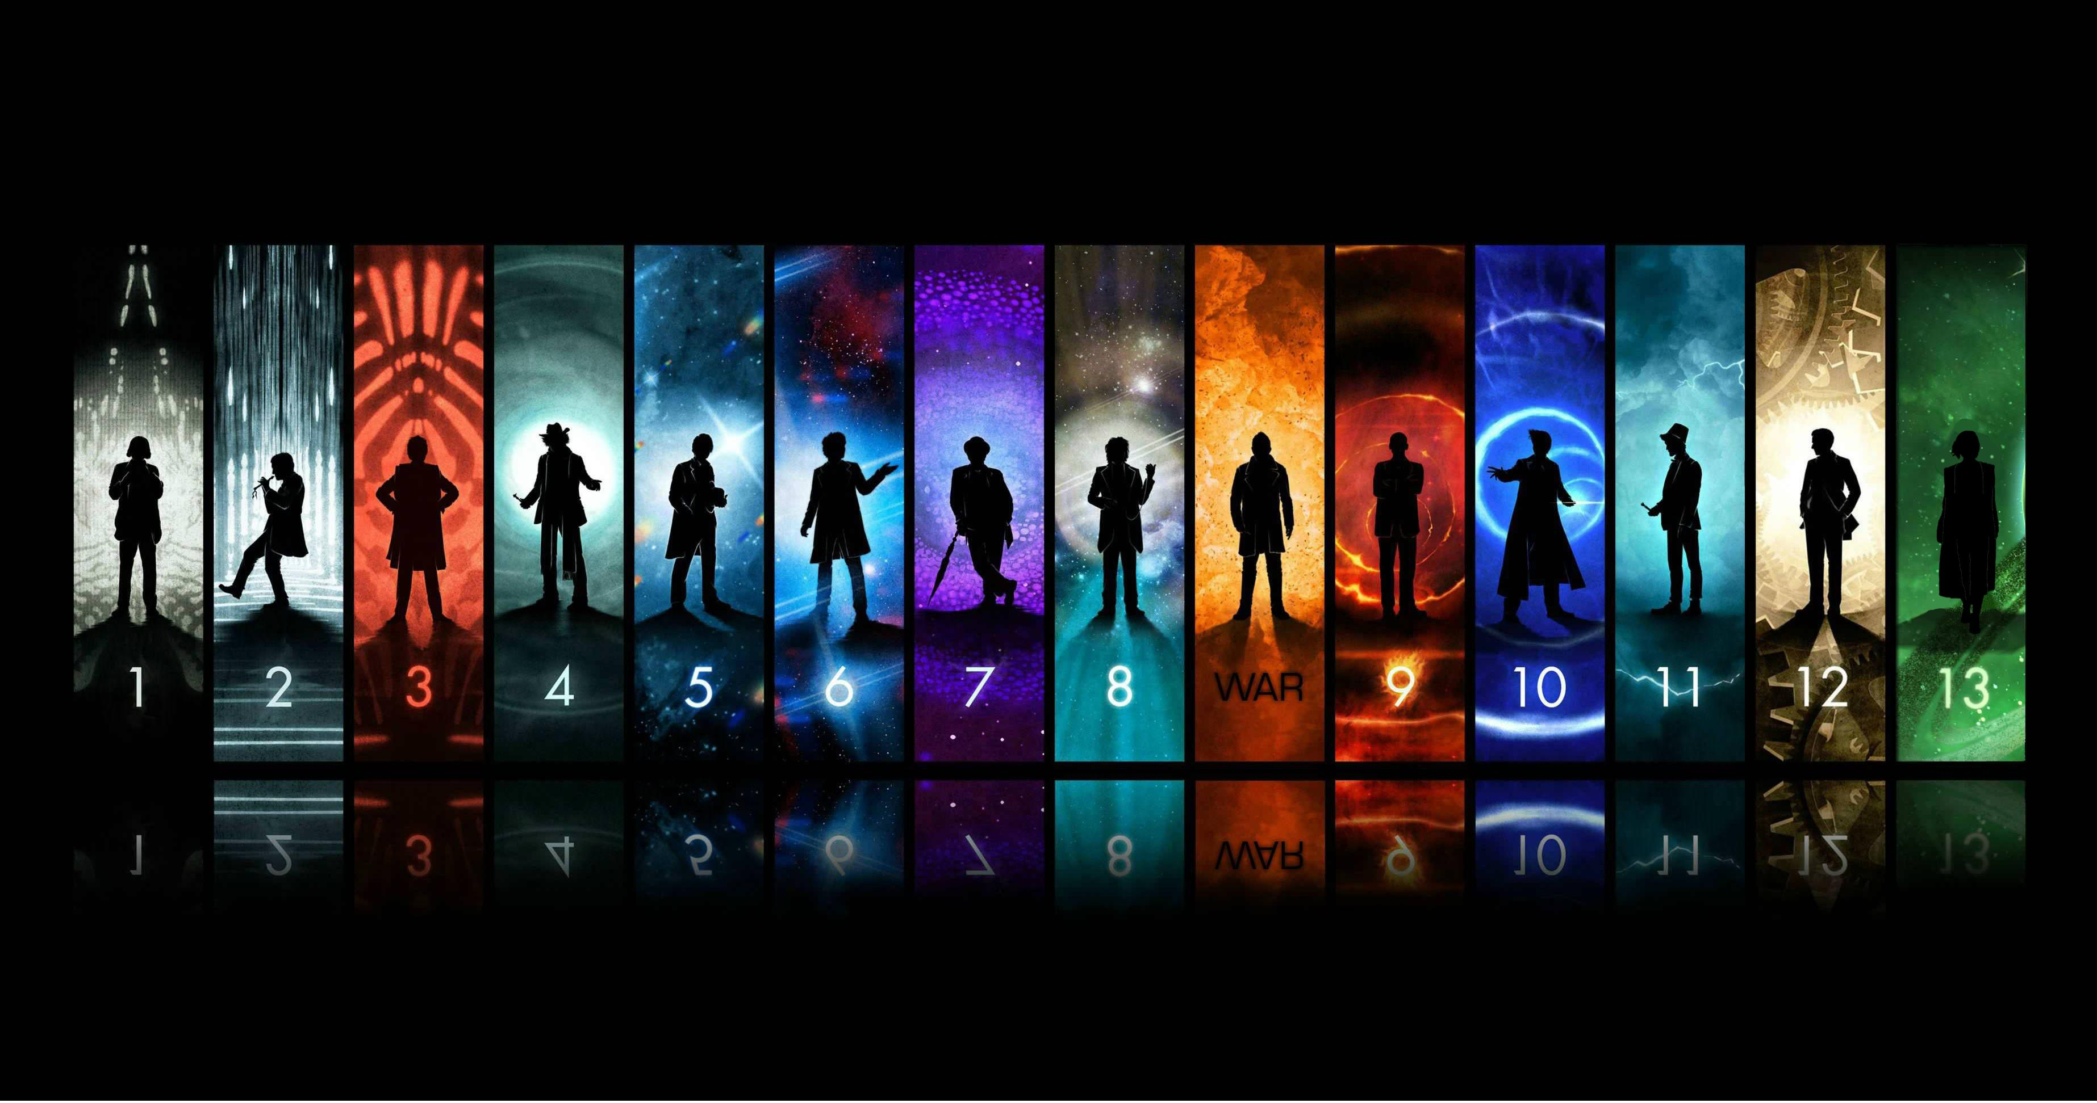
A ‘Brief’ History of Time and Space

Slide 2
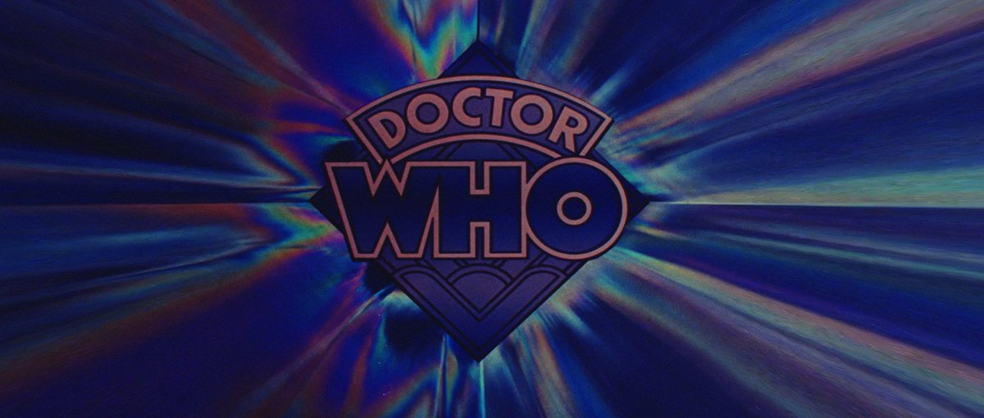
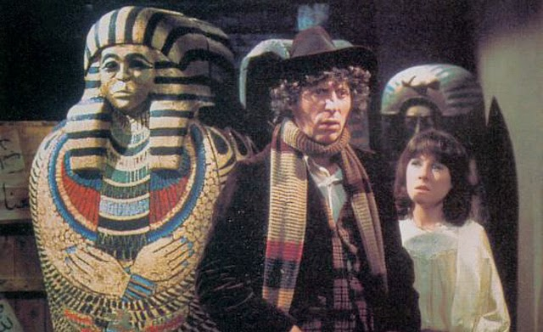
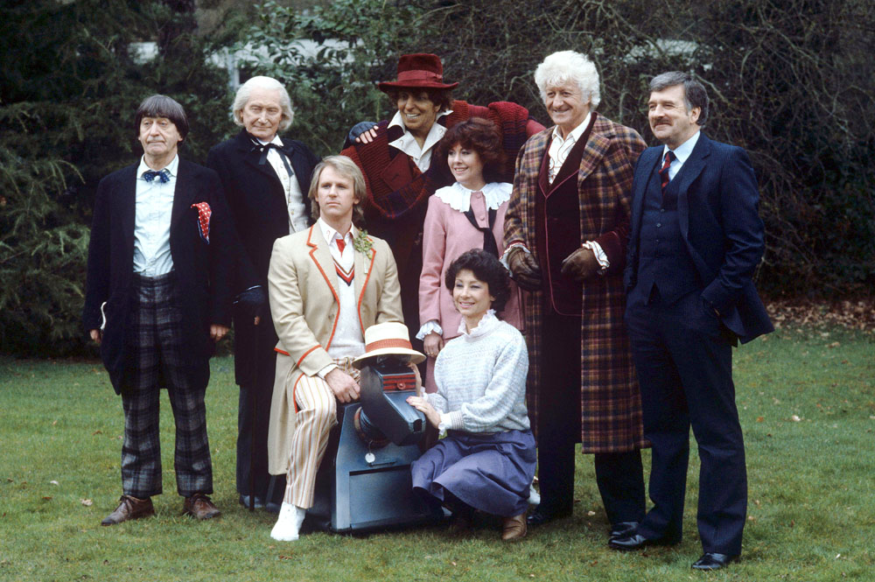
My early experiences
4th Doctor Credits: https://www.youtube.com/watch?v=1fnzcAFy8d8

Slide 3
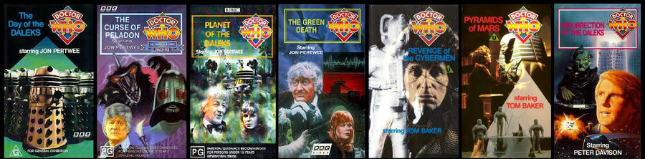
Early VHS Releases

Slide 5
22 November 1963

Slide 6
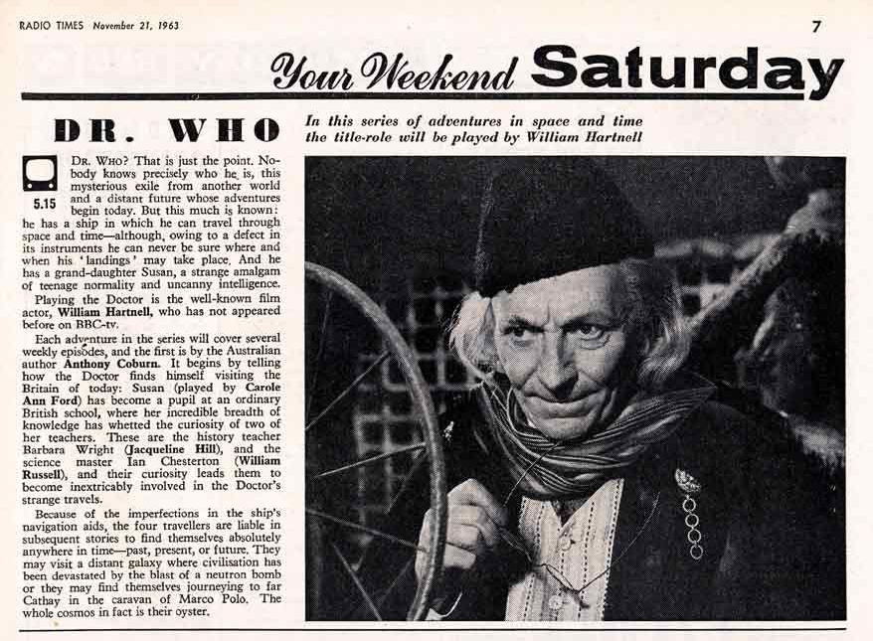
Doctor Who first opening- William Hartnell 1963
https://www.youtube.com/watch?v=YN7pCuNtO6Q

Slide 7
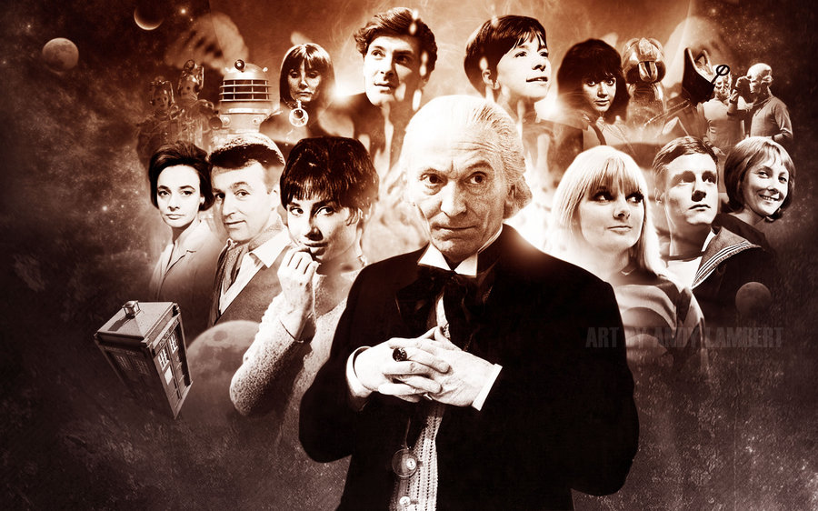
BBC Brief
Mixture between education and entertainment
First Doctor Era, Ultimate trailer
https://www.youtube.com/watch?v=O-JXjmXOsPE&list=PLGnwAQXWWDZ2wOxQlUPPn6lwT9JB-G1l1&index=1

Slide 8
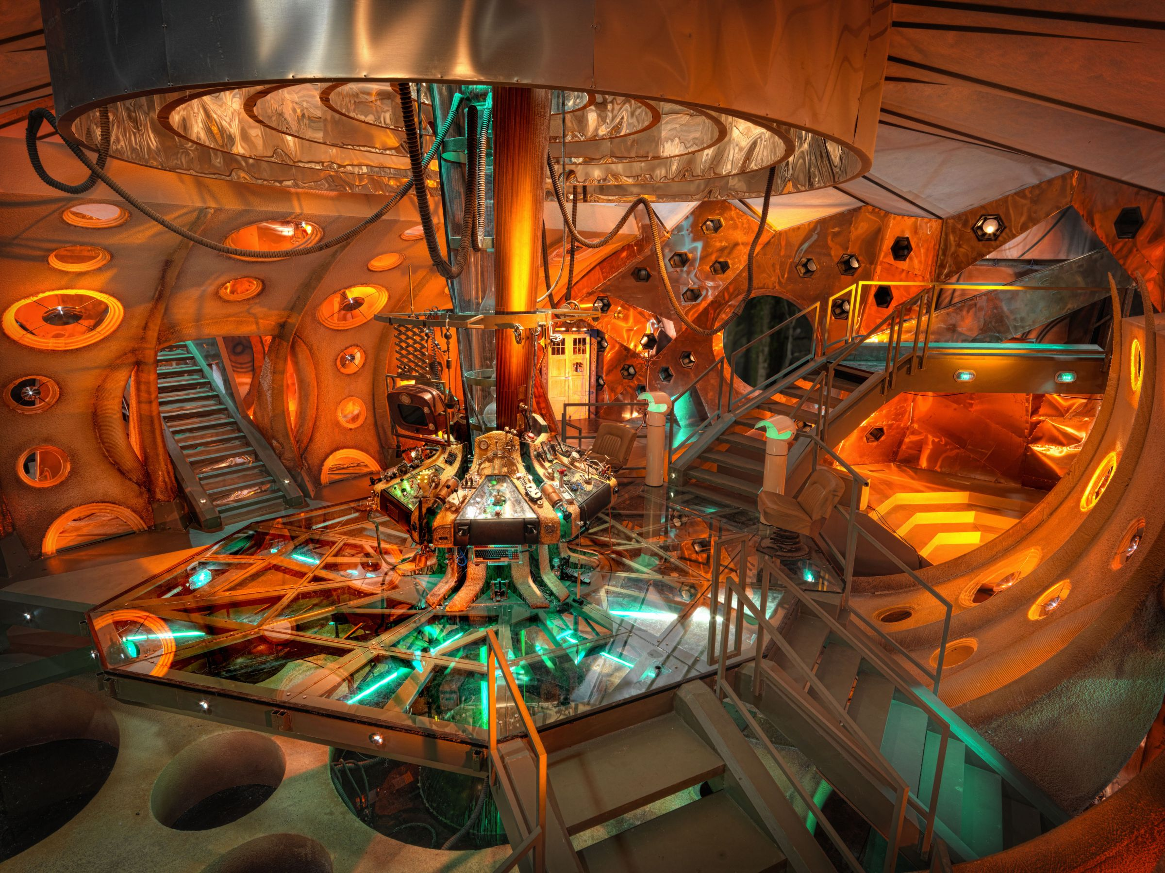
The T.A.R.D.I.S
Time
And
Relative
Dimensions
In
Space
Can travel anywhere in time and space
Not always reliable – doesn’t always go where expected
Bigger on the inside
Has a “Chameleon Circuit” to blend in with environment, but this became stuck so it looks like a 1963 Police Box

Slide 9
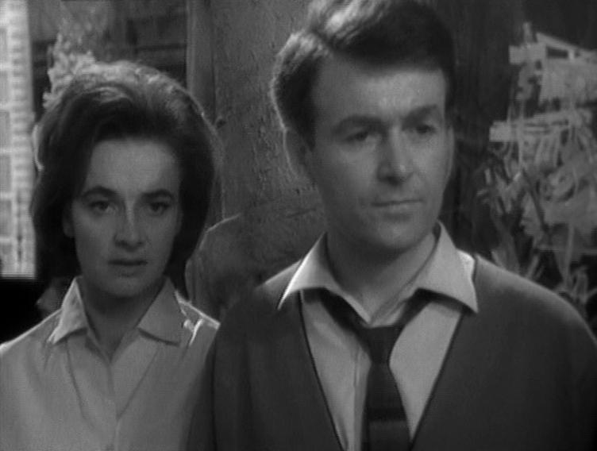
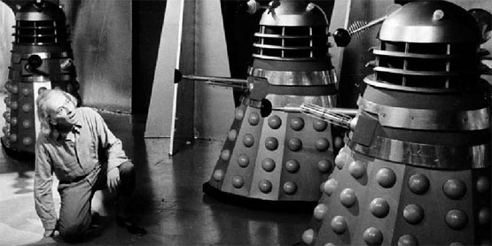
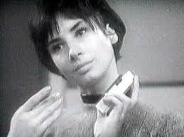
An Unearthly Child
The Daleks
The Edge of Destruction
Marco Polo
The Keys of Marinus
The Aztecs
The Sensorites
The Reign of Terror
Episodes … and deletions
Planet of Giants
The Dalek Invasion of Earth
The Rescue
The Romans
The Web Planet
The Crusade
The Space Museum
The Chase
The Time Meddler
Time Meddler – The Doctor finds another of his own Race

Slide 10
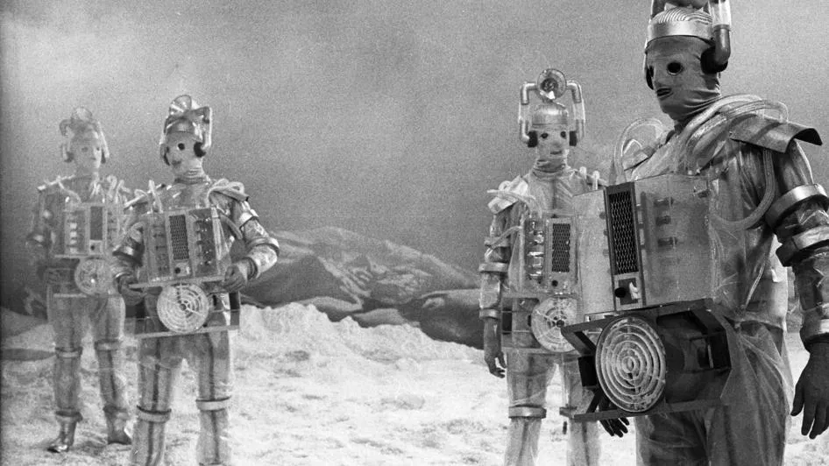
Galaxy 4
Mission to the Unknown
The Myth Makers
The Daleks' Master Plan
The Massacre
The Ark
The Celestial Toymaker
The Gunfighters
The Savages
The War Machines
The Smugglers
The Tenth Planet
First Doctor regenerates
https://www.youtube.com/watch?v=NctqgICb0DM

Slide 11
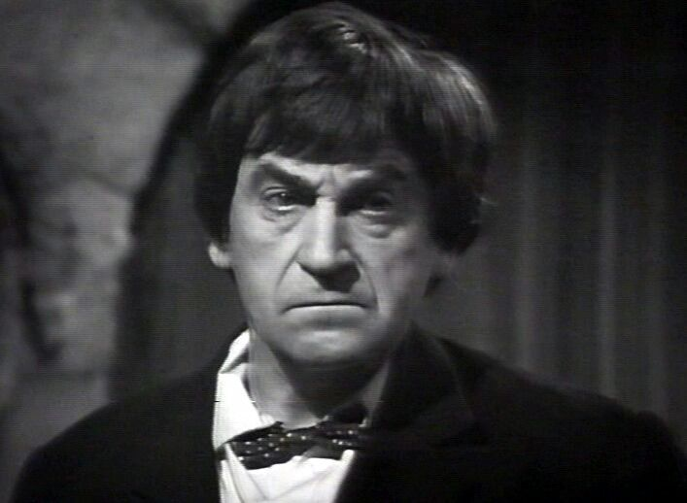
Second Doctor - Patrick Troughton
The Power of the Daleks
The Highlanders
The Underwater Menace
The Moonbase
The Macra Terror
The Faceless Ones
The Evil of the Daleks
The Tomb of the Cybermen
The Abominable Snowmen
The Ice Warriors
The Enemy of the World
The Web of Fear
Fury from the Deep
The Wheel in Space
Second Doctor Era, Ultimate trailer
https://www.youtube.com/watch?v=tBlOvAFKY5g&list=PLGnwAQXWWDZ2wOxQlUPPn6lwT9JB-G1l1&index=2

Slide 12
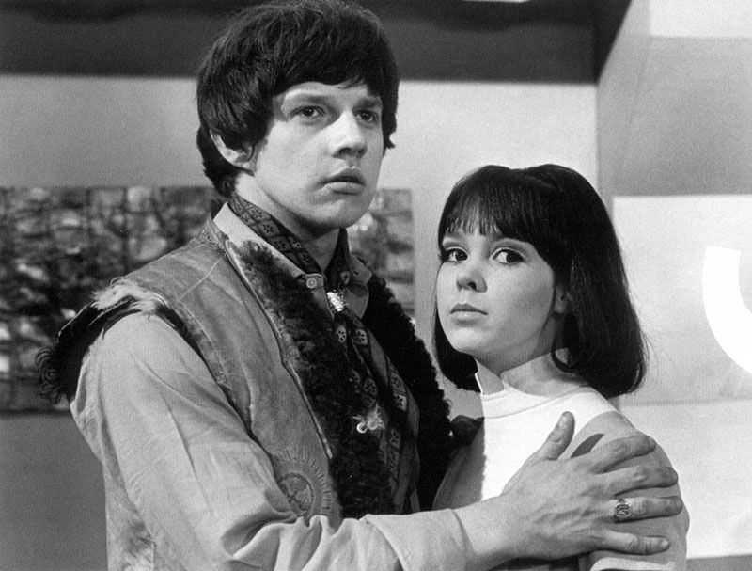
The Dominators
The Mind Robber
The Invasion
The Krotons
The Seeds of Death
The Space Pirates
The War Games
War Games: First time Time Lords are named
Second Doctor regenerates
https://www.youtube.com/watch?v=XjIZPl3ABXo

Slide 13
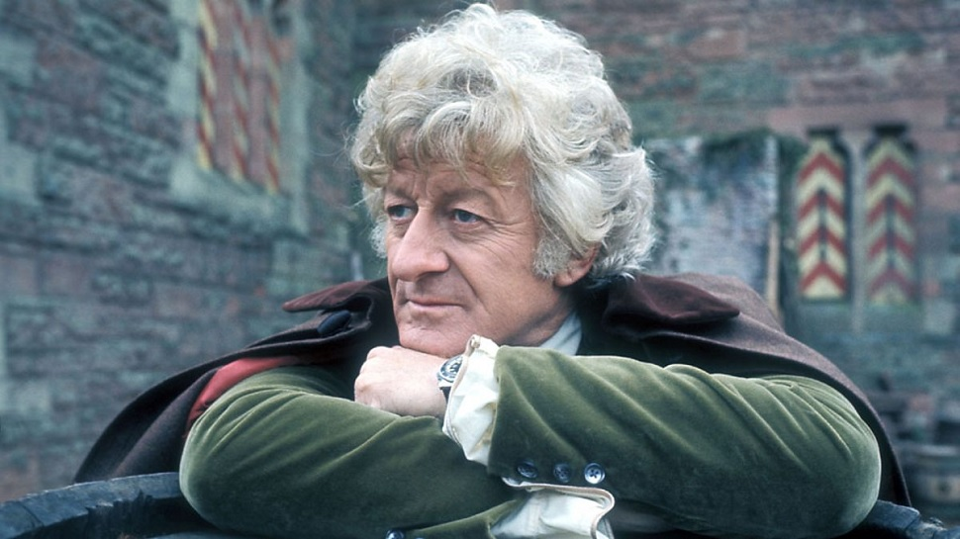
Third Doctor – Jon Pertwee
Response to external events
Earth Based
Recurring characters
Recurring villain
“Dream Team”
10th Anniversary

Slide 14
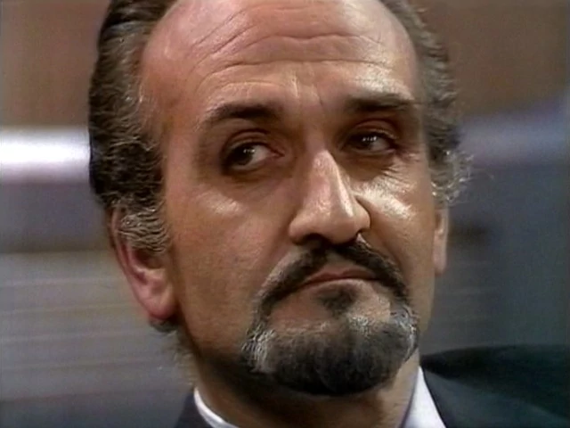
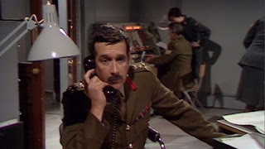
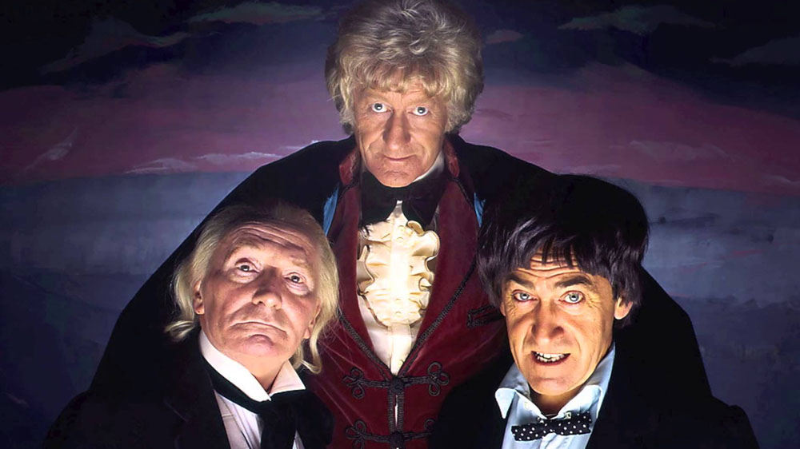
The Three Doctors Unite! https://www.youtube.com/watch?v=I6Uf4sjX8RE
Planet of the Spiders – first time “regeneration” is mentioned

Slide 15
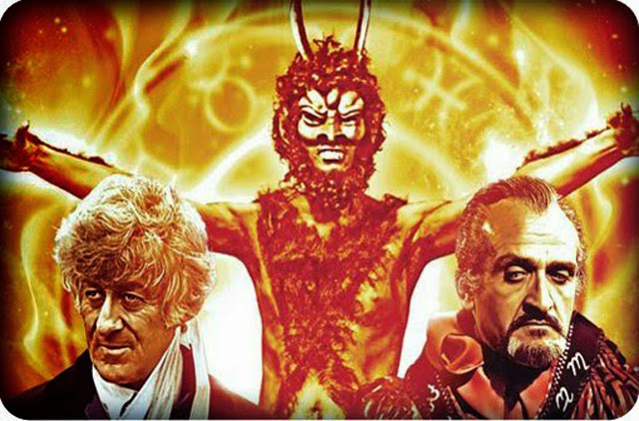
Season Ten - 1972-1973
The Three Doctors Carnival of Monsters Frontier In Space Planet of the Daleks The Green Death
Season Eleven - 1973 - 1974
The Time Warrior Invasion of the Dinosaurs Death to the Daleks The Monster of Peladon Planet of the Spiders
Scene from The Dæmons: Five rounds, rapid! https://www.youtube.com/watch?v=0grVDUL_en0
Third Doctor era, Ultimate trailer
https://www.youtube.com/watch?v=IiM1Rc9P7V8

Slide 16
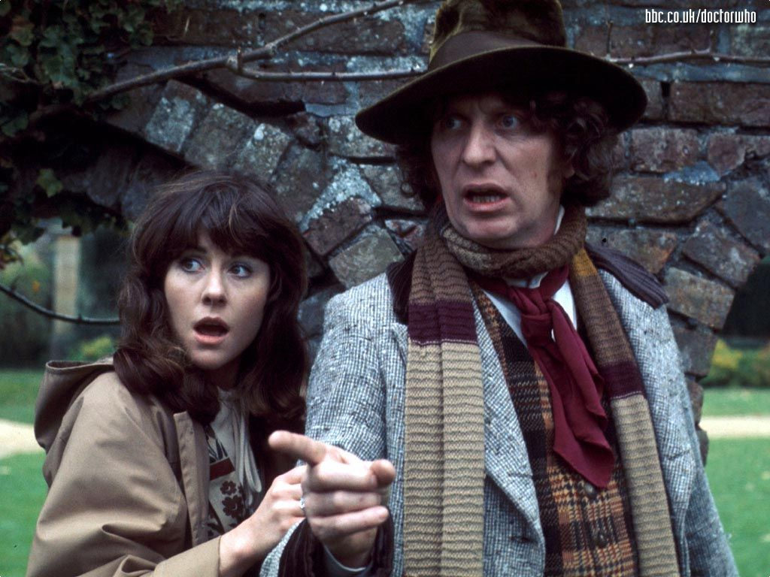
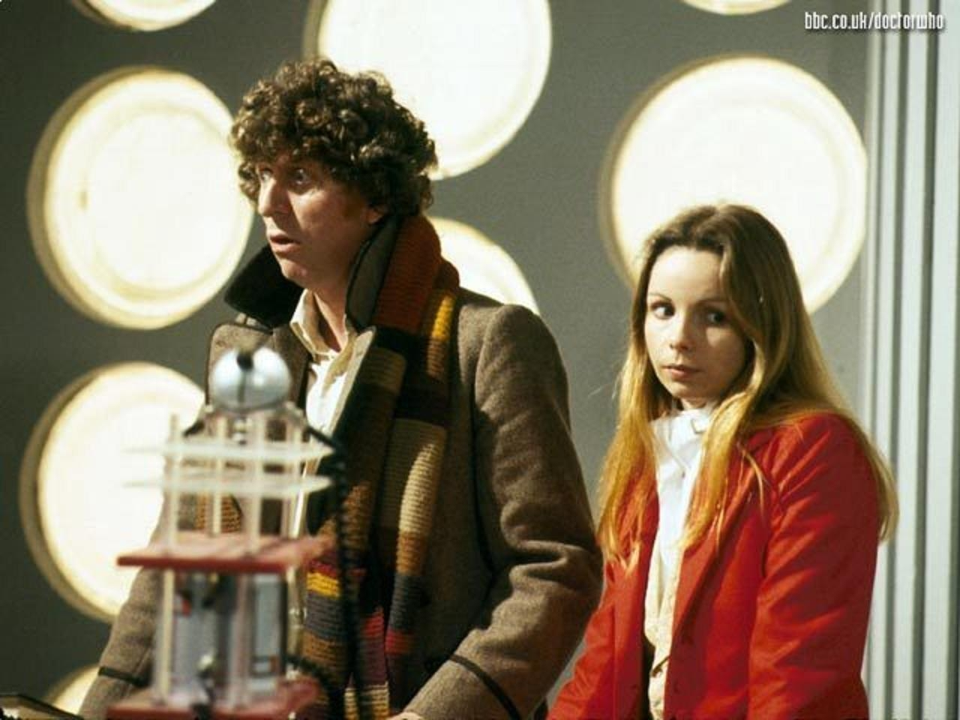
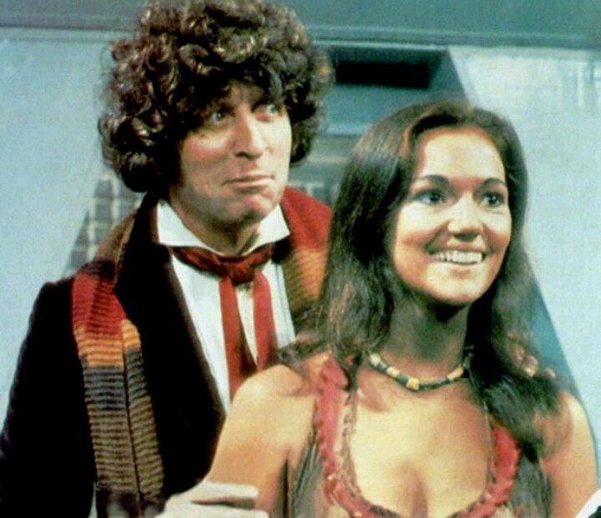
Fourth Doctor – Tom Baker
Longest serving ‘classic’ doctor
Beloved companions

Slide 17
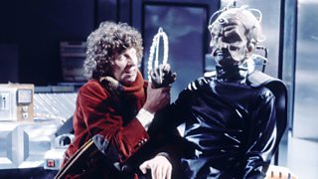
The Deadly Assassin – The Doctor goes to his homeworld – Galifrey
And we find out where the Daleks come from.
And the Doctor has a chance to destroy the Dalek threat before it’s even started
The Doctor and Davros - Genesis of the Daleks https://www.youtube.com/watch?v=dkelV2WUNdw
Do I Have the right? - Genesis of the Daleks https://www.youtube.com/watch?v=9PXdwqlJ19U

Slide 18
Season Seventeen - 1979-80
Destiny of the Daleks City of Death The Creature from the Pit Nightmare of Eden The Horns of Nimon Shada
Season Eighteen - 1980-81
The Leisure Hive Meglos The E-Space Trilogy Full Circle State of Decay Warriors' Gate The Keeper of Traken Logopolis
Season Twelve - 1974-75
Robot The Ark in Space The Sontaran Experiment Genesis of the Daleks Revenge of the Cybermen
Season Thirteen - 1975-76
Terror of the Zygons Planet of Evil Pyramids of Mars The Android Invasion The Brain of Morbius The Seeds of Doom
Season Fourteen - 1976-77
The Masque of Mandragora The Hand of Fear The Deadly Assassin The Face of Evil The Robots of Death The Talons of Weng-Chiang
Season Fifteen - 1977-78
Horror of Fang Rock The Invisible Enemy Image of the Fendahl The Sun Makers Underworld The Invasion of Time
Season Sixteen - 1978-79
The Ribos Operation The Pirate Planet The Stones of Blood The Androids of Tara The Power of Kroll The Armageddon Factor
Fourth Doctor era, Ultimate trailer
https://www.youtube.com/watch?v=1NJzaPF2XI0

Slide 19
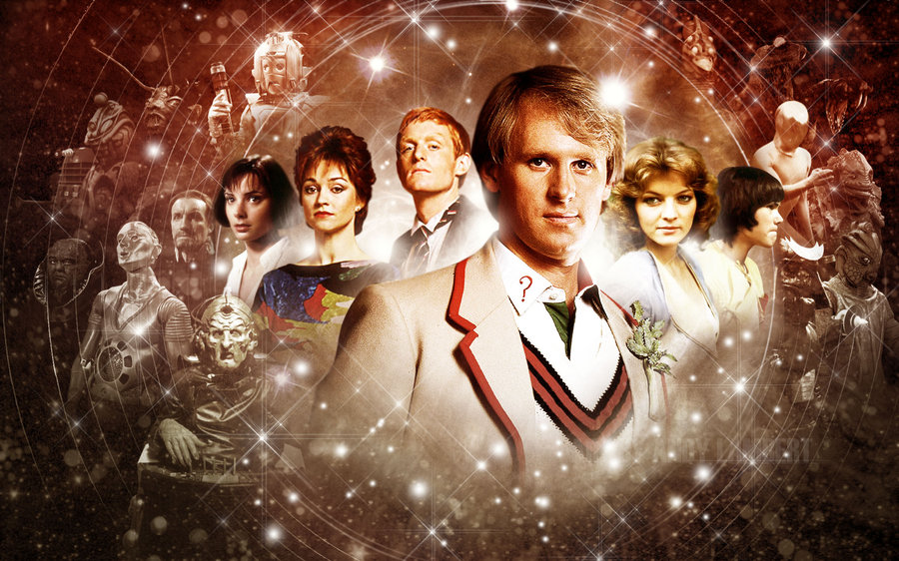
Fifth Doctor - Peter Davidson
Season Nineteen - 1982
Castrovalva Four To Doomsday Kinda The Visitation Black Orchid Earthshock Time-Flight
Season Twenty - 1983
Arc of Infinity Snakedance Mawdryn Undead Terminus Enlightenment The King's Demons
The Five Doctors (20th anniversary Special)
Season Twenty-One - 1984
Warriors of the Deep The Awakening Frontios Resurrection of the Daleks Planet of Fire The Caves of Androzani
Fifth Doctor era, ultimate trailer
https://www.youtube.com/watch?v=mMrEexETnQY&list=PLGnwAQXWWDZ2wOxQlUPPn6lwT9JB-G1l1&index=5

Slide 20
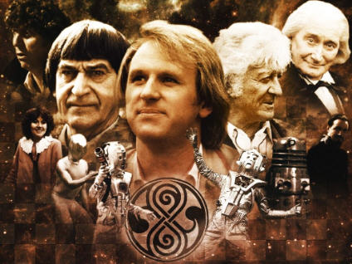
Seeking Immortality - Doctor Who - The Five Doctors
https://www.youtube.com/watch?time_continue=8&v=R7WRrmTcUGg

Slide 21
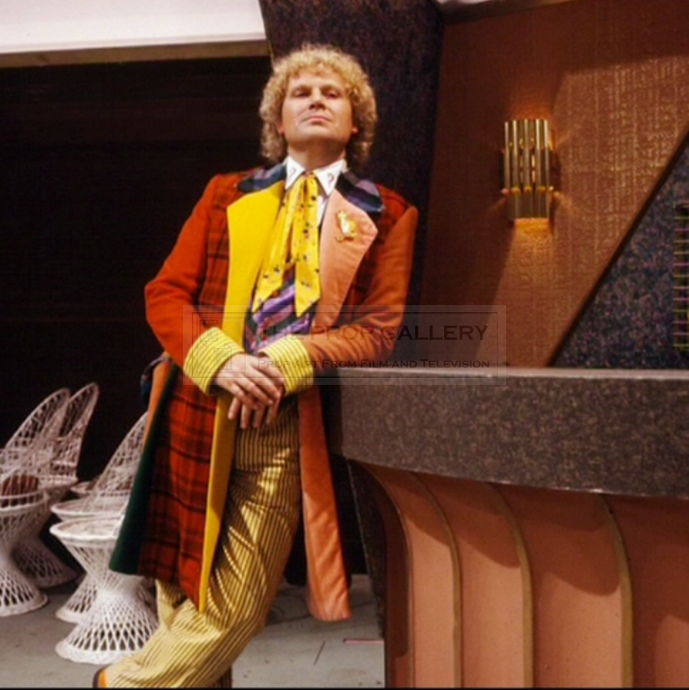
Season Twenty-One – 1984 (Continued)
The Twin Dilemma
Season Twenty-Two - 1985
Attack of the Cybermen Vengeance On Varos The Mark of the Rani The Two Doctors Timelash Revelation of the Daleks
Eighteen Month ‘hiatus” between seasons
Season Twenty-Three- 1986
The Trial of a Timelord: The Mysterious Planet Mindwarp Terror of the Vervoids The Ultimate Foe
Sixth Doctor era Ultimate trailer
https://www.youtube.com/watch?v=2tHzWFhTrAY&list=PLGnwAQXWWDZ2wOxQlUPPn6lwT9JB-G1l1&index=6

Slide 22
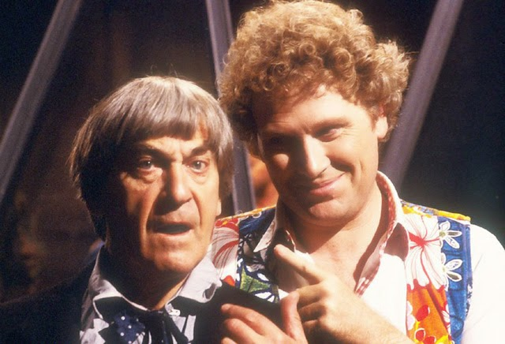
The Friend Within: Scene from “The Two Doctors”
https://www.youtube.com/watch?v=nCjm4KRjsIM

Slide 23
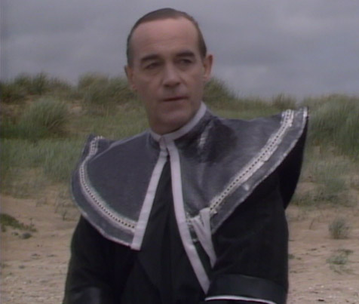
The Sixth Doctor’s last Season
The Trial of a Time Lord (four linked stories)
The Enemy Within
The Doctor Denounces The Timelords: https://www.youtube.com/watch?v=Y2INBe_qZFo
The Moment of the Valeyard (article) http://www.warpedfactor.com/2015/09/doctor-who-series-nine-moment-of.html

Slide 24
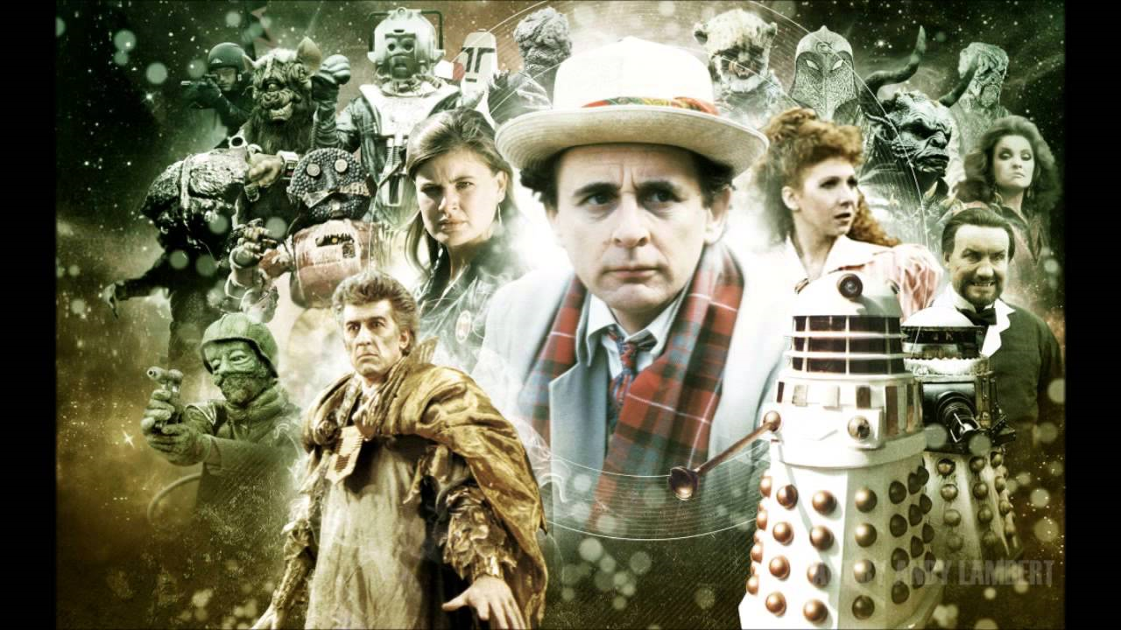
Seventh Doctor – Sylvester McCoy
Season Twenty-Four - 1987
Time And the Rani Paradise Towers Delta And the Bannermen Dragonfire
Season Twenty-Five - 1988
Remembrance of the Daleks The Happiness Patrol Silver Nemesis The Greatest Show In the Galaxy
Season Twenty-Six - 1989
Battlefield Ghost Light The Curse of Fenric Survival
The Seventh Doctor Highlights
https://www.youtube.com/watch?v=yU5g7kLqMQ8

Slide 25
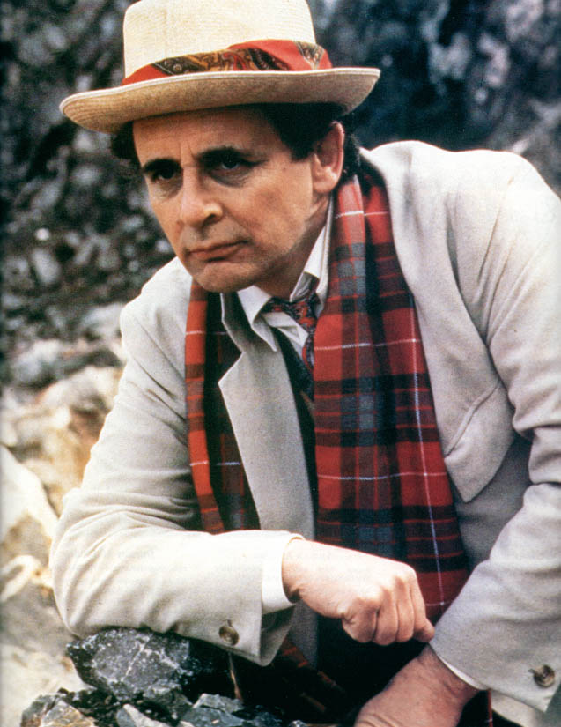
Seventh Doctor – Sylvester McCoy
A Dalek surprises the Doctor
https://www.youtube.com/watch?v=KGO3AzH2ePo
The Doctor Fights with the Master: “If we fight like animals, we die like animals!”
https://www.youtube.com/watch?v=IbQa8C9t4mY&t=1s
Walk off into the sunset: “Come on Ace, we’ve got work to do.”
https://www.youtube.com/watch?v=f_1LKxS-iR0
Last broadcast 6 December 1989

Slide 26
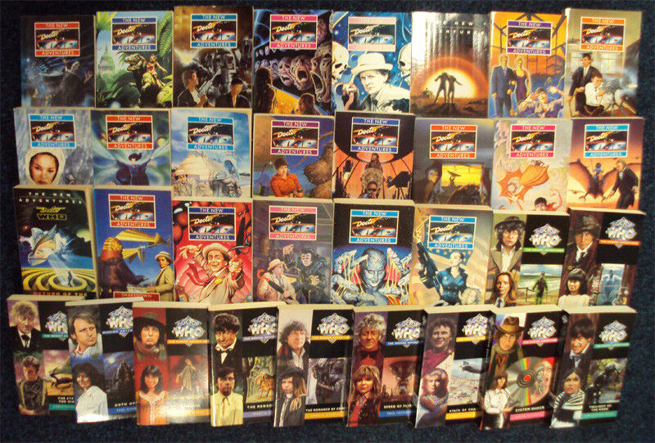
The Long Darkness…
Dimensions in Time – BBC Children in Need Special (1993)
https://www.youtube.com/watch?v=NQCeMIQpFBc
(Do not watch more than three minutes of this!)
Doctor Who Magazine continued to be published (First issue was 17 October 1979)
Virgin New Adventures and Missing Adventures series, started in 1991
BBC Doctor Who Paperback series started in 1997

Slide 27
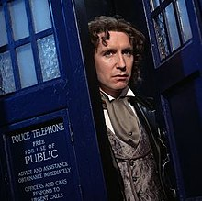
Rumours of the Eighth (and it’s about time)
Doctor Who Movie(1996) (ultimate trailer)
https://www.youtube.com/watch?v=xyIv0FrwHFo
Paul McGann’s final appearance: “The Night of the Doctor”
https://www.youtube.com/watch?v=-U3jrS-uhuo

Slide 28
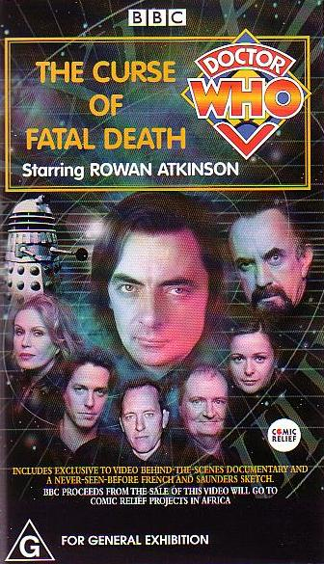
The Second Long Darkness…
The Curse of the Fatal Death – BBC Children in Need Special (1997)
https://www.youtube.com/watch?v=i9EhGsKTPmo (trailer)
https://www.youtube.com/watch?v=tp_Fw5oDMao (full story)
Big Finish Audio Dramas (started 1999)
Featuring 4th-8th Doctors

Slide 29
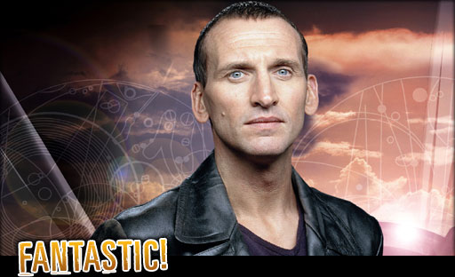
Rumours of the Ninth (Christopher Eccleston)
Reboot series began in 2005

Slide 30
And rumours of Billie …
Billie: Because we want to: https://www.youtube.com/watch?v=D_XI_290cfw

Slide 31
Ninth Doctor – Christopher Eccleston (2005)
Rose
The End Of The World
The Unquiet Dead
Aliens Of London
World War Three
Dalek
The Long Game
Father's Day
The Empty Child
The Doctor Dances
Boom Town
Bad Wolf
The Parting Of The Ways
Ninth Doctor Ultimate Trailer: https://www.youtube.com/watch?v=c7MxySI0tC8

Slide 32
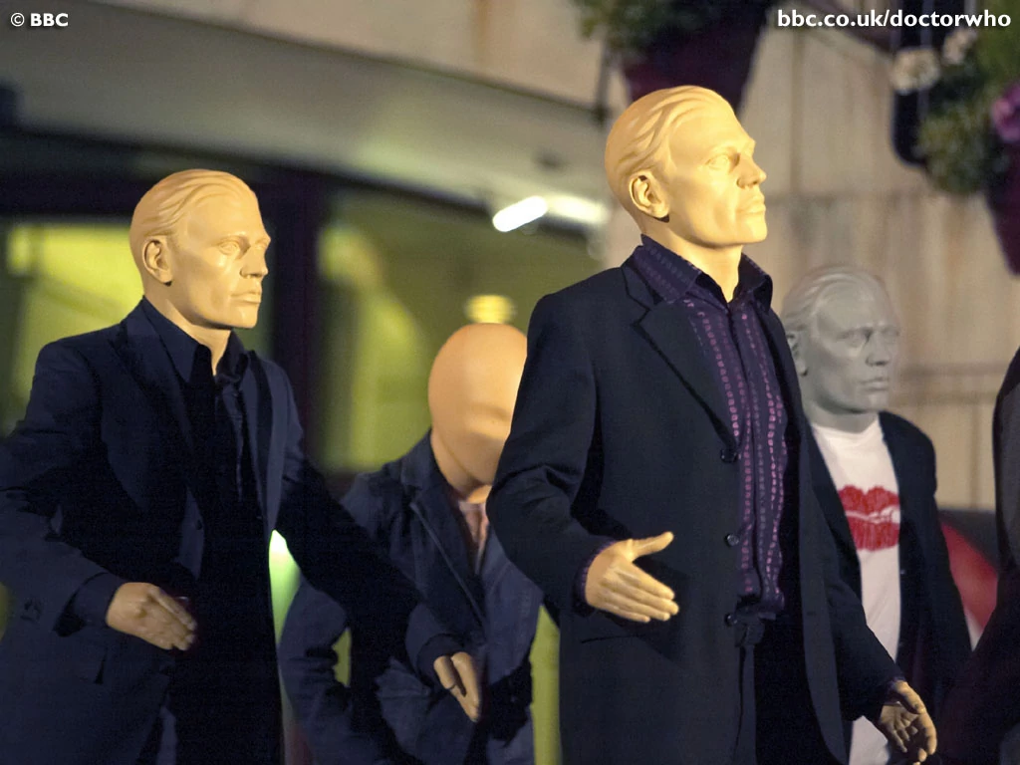
And the story begins
Rose and the Doctor: https://www.youtube.com/watch?v=bRBQZdBqoOU
And much more complicated than before (Facing down the “Last” Dalek)
https://www.youtube.com/watch?v=jIjUSzpYcuA

Slide 33
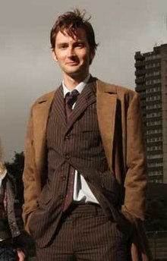
Tenth Doctor – David Tennant (2005-2010
The Christmas Invasion
Season Two
New Earth
Tooth and Claw
School Reunion
The Girl in the Fireplace
Rise of the Cybermen
The Age of Steel
The Idiot's Lantern
The Impossible Planet
The Satan Pit
Love & Monsters
Fear Her
Army of Ghosts
Doomsday
The Runaway Bride
Season Four
Partners in Crime
The Fires of Pompeii
Planet of the Ood
The Sontaran Stratagem
The Poison Sky
The Doctor's Daughter
The Unicorn and the Wasp
Silence in the Library
Forest of the Dead
Midnight
Turn Left
The Stolen Earth
Journey's End
The Next Doctor
Season Four – (The Specials)
Planet of the Dead
The Waters of Mars
The End of Time - Part One
The End of Time - Part Two
Season Three
Smith and Jones
The Shakespeare Code
Gridlock
Daleks in Manhattan
Evolution of the Daleks
The Lazarus Experiment
42
Human Nature
The Family of Blood
Blink
Utopia
The Sound of Drums
The Last of the Time Lords
Voyage of the Damned
Tenth Doctor Era Ultimate trailer:
https://www.youtube.com/watch?v=DB8cN8to0Aw

Slide 34
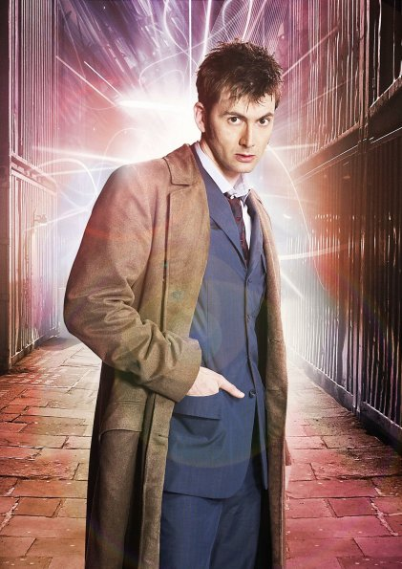
Tenth Doctor (Highlights)
I'm the Doctor...Got a Problem With That? – Voyage of the Damned:
https://www.youtube.com/watch?v=z8lBEoPi6OY
The Doctor Smashes Through The Time Window – The Girl in the Fireplace
https://www.youtube.com/watch?time_continue=2&v=MSecHsvREd0
Don’t Blink
https://www.youtube.com/watch?v=cwdbLu_x0gY
The Fury of a Time Lord: The Family of Blood
https://www.youtube.com/watch?time_continue=2&v=w4xm9NHNUf8
Ten’s regeneration
https://www.youtube.com/watch?v=_68Vyc24i1s

Slide 35
Eleventh Doctor – Matt Smith (2010-2013
Season Seven - Part One
Asylum Of The Daleks
Dinosaurs On A Spaceship
A Town Called Mercy
The Power Of Three
The Angels Take Manhattan
The Snowmen
Season Seven - Part Two
The Bells Of Saint John
The Rings Of Akhaten
Cold War
Hide
Journey To The Centre Of The TARDIS
The Crimson Horror
Nightmare In Silver
The Name Of The Doctor
Season Eight -
The Day Of The Doctor (50th Anniversary Special)
The Time Of The Doctor (Christmas Special)
Season Five
The Eleventh Hour
The Beast Below
Victory Of The Daleks
The Time Of Angels
Flesh And Stone
The Vampires Of Venice
Amy's Choice
The Hungry Earth
Cold Blood
Vincent And The Doctor
The Lodger
The Pandorica Opens
The Big Bang
A Christmas Carol
Season Six - Part One
The Impossible Astronaut
Day Of The Moon
The Curse Of The Black Spot
The Doctor's Wife
The Rebel Flesh
The Almost People
A Good Man Goes To War
Season Six - Part Two
Let's Kill Hitler
Night Terrors
The Girl Who Waited
The God Complex
Closing Time
The Wedding Of River Song
The Doctor, The Widow And The Wardrobe
Eleventh Doctor era Ultimate Trailer:
https://www.youtube.com/watch?v=QMqTho1rAeU

Slide 36
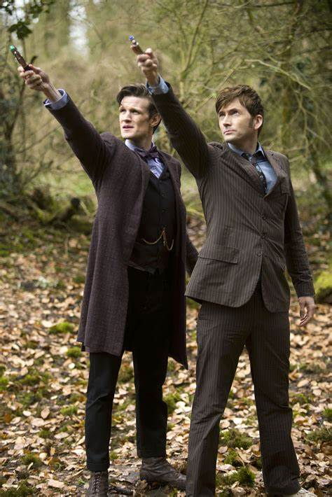
Eleventh Doctor – Matt Smith
Van Gogh Visits the Musee d’Orsay: Vincent and the Doctor: https://www.youtube.com/watch?time_continue=3&v=ubTJI_UphPk
Eleventh Doctor meets the Tenth: Day of the Doctor https://www.youtube.com/watch?time_continue=1&v=DLjJwW1lFxI
I. Am. Talking: The Pandorica Opens: https://www.youtube.com/watch?time_continue=5&v=5ecycHAZtaM

Slide 37
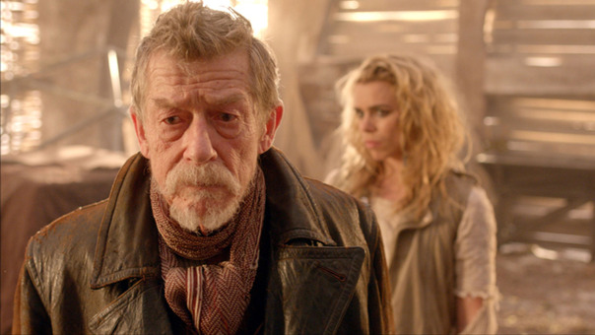
10th/50th Anniversary 23 November 2013
The Last Day of the Time War
https://www.youtube.com/watch?v=NdfUt2RZjZE

Slide 38
Twelfth Doctor – Peter Capaldi 2014-2017)
Season Ten
The Pilot
Smile
Thin Ice
Knock Knock
Oxygen
Extremis
The Pyramid At The End Of The World
The Lie Of The Land
Empress Of Mars
The Eaters Of Light
World Enough And Time
The Doctor Falls
Twice Upon A Time
Season Eight
Deep Breath
Into The Dalek
Robot Of Sherwood
Listen
Time Heist
The Caretaker
Kill The Moon
Mummy On The Orient Express
Flatline
In The Forest Of The Night
Dark Water
Death In Heaven
Last Christmas
Season Nine
The Magician's Apprentice
The Witch's Familiar
Under The Lake
Before The Flood
The Girl Who Died
The Woman Who Lived
The Zygon Invasion
The Zygon Inversion
Sleep No More
Face The Raven
Heaven Sent
Hell Bent
The Husbands Of River Song
The Return Of Doctor Mysterio
Twelfth Doctor Era Ultimate Trailer:
https://www.youtube.com/watch?v=TUNniOBRYrM

Slide 39
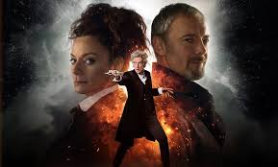
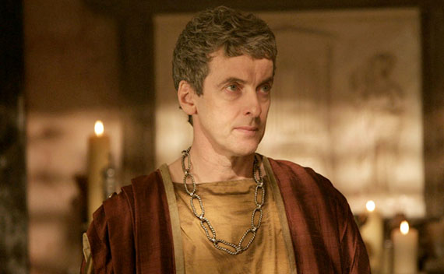
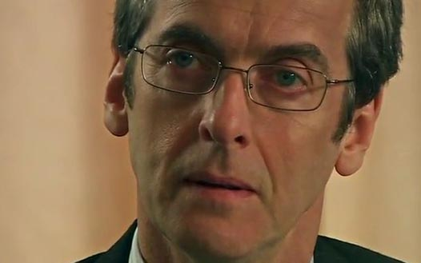
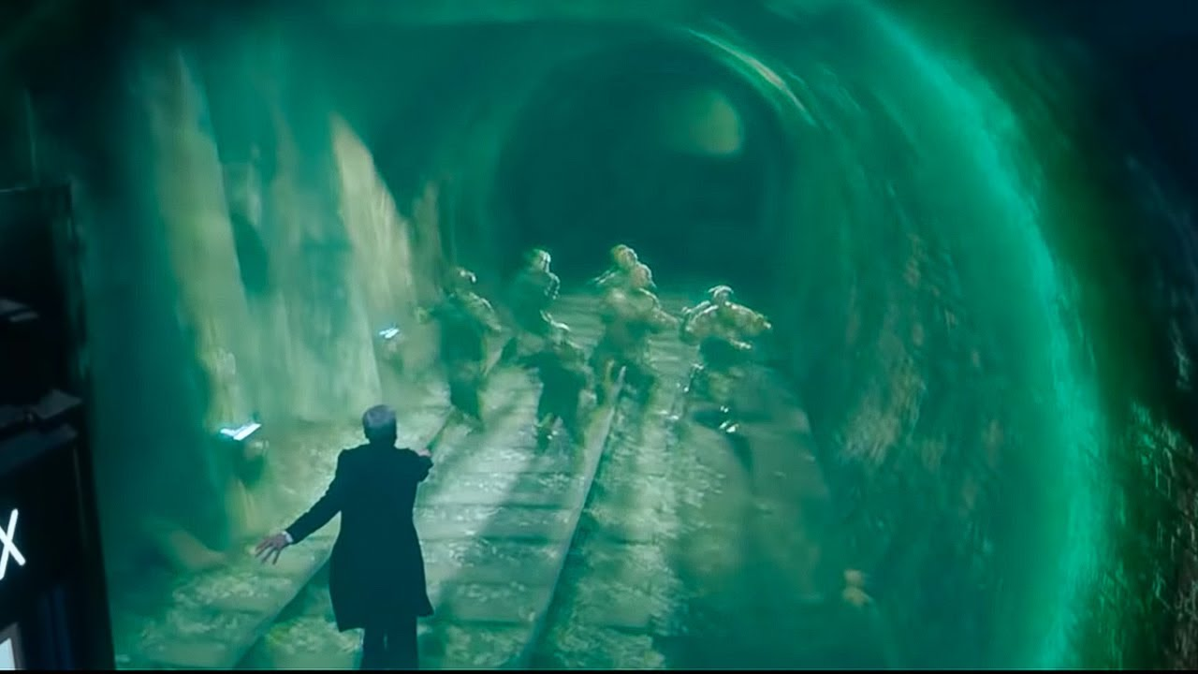
Twelfth Doctor – Peter Capaldi
Peter Capaldi’s first appearence
https://www.youtube.com/watch?v=WDwxTXypdlE
Frobisher: Children of Earth
https://www.youtube.com/watch?v=q5km0ucRU3g
The Man who stops the monsters: Flatline
https://www.youtube.com/watch?v=iG4Vxy116Uo

Slide 40
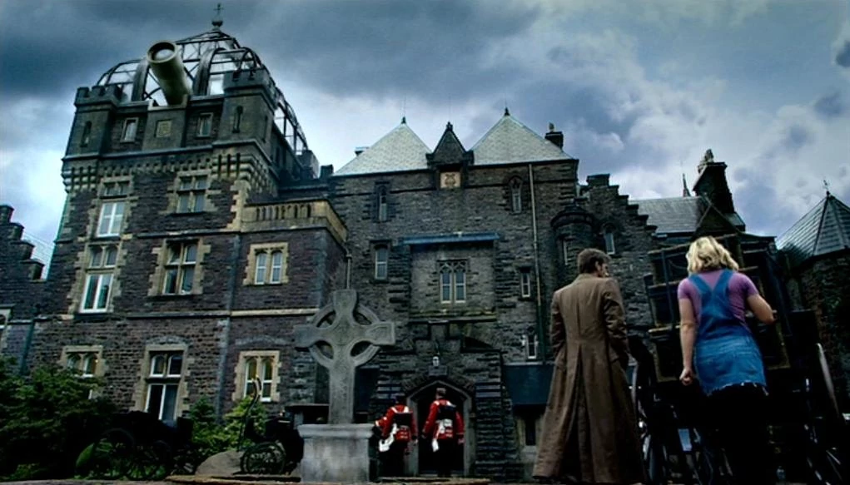
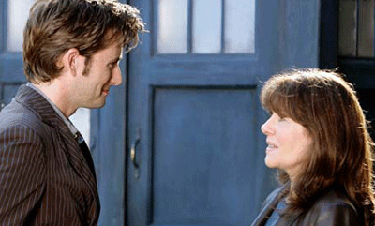
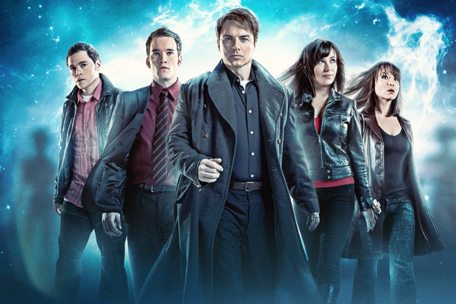
Spin-offs
http://www.visittorchwood.co.uk/observatory.htm
Class: Trailer
https://www.youtube.com/watch?v=G18EhxyBOcE
Torchwood: Trailer:
https://www.youtube.com/watch?v=ZVUhJSuu2hk
The Sarah Jane Adventures: Trailer
https://www.youtube.com/watch?v=SDjscQZKasY

Slide 41
All things Change
The Doctor Falls:
https://www.bing.com/videos/search?q=the+tenth+planet+doctor+who+episode+4&&view=detail&mid=E9D3C3E8C2CEAE3FCACAE9D3C3E8C2CEAE3FCACA&&FORM=VRDGAR (at 21 Minutes)
Twice Upon a Time
https://www.youtube.com/watch?v=5eVj_wrq8Kc
Capaldi’s valediction: https://www.youtube.com/watch?v=yJqsPBWbtjk

Slide 42
Thirteenth Doctor – Jodi Whittaker (2018-Present)
Introducing … https://www.youtube.com/watch?v=_-_bSdWEYK8
Season Eleven
The Woman Who Fell To Earth
The Ghost Monument
Rosa
Arachnids In The UK
The Tsuranga Conundrum
Demons Of The Punjab
Kerblam!
The Witchfinders
It Takes You Away
The Battle Of Ranskoor Av Kolos
Resolution
Season Twelve
Spyfall: Part One Spyfall: Part Two Orphan 55 Nikola Tesla's Night Of Terror Fugitive Of The Judoon Praxeus Can You Hear Me? The Haunting Of Villa Diodati Ascension Of The Cybermen The Timeless Children
Revolution of the Daleks

Slide 43
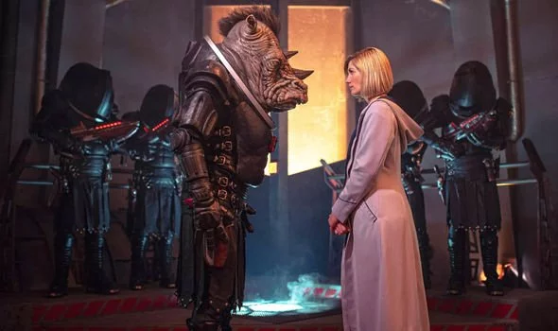
Look back: Season 11 Trailer: https://www.youtube.com/watch?v=3utdZJ6rOhM
Season 12: “This new run is much scarier than Jodie’s first year and will ­definitely put the frighteners on fans. Things are about to get darker for the Doctor.”
Season 12 Trailer: https://www.youtube.com/watch?v=mkIMo1e5HWQ

Slide 44
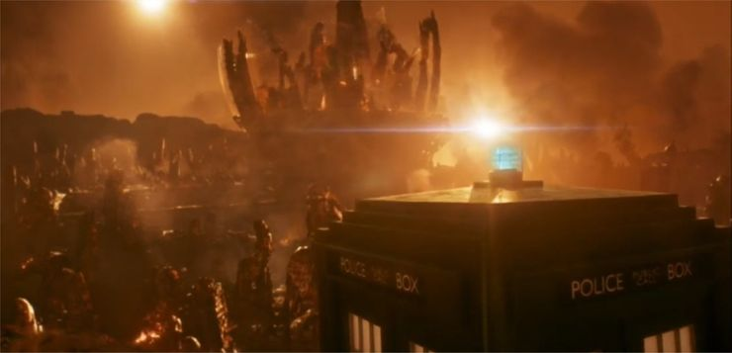
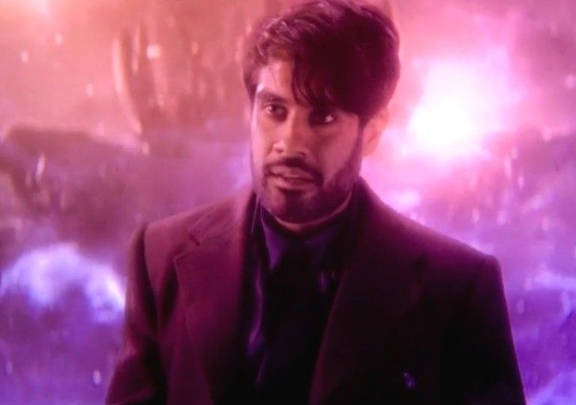
The Future
No spoilers here, but in Season 12, EVERYTHING changes

Slide 45
Fantasy Theorists
Mendlesohn
PORTAL QUEST FANTASY
(The TARDIS)
IMMERSIVE FANTASY
(The Whoniverse), although with frequent references to Historical, contemporary and Future Earth
INTRUSION FANTASY
(The Doctor is the bringer of both chaos and order)
Todorov
Stories often begin in the “Uncanny” for the characters where they don’t realise that the laws that govern the world in which they live have been breached.
However, most of the content is in the PURE MARVELLOUS
Scientific Marvellous
Exotic Marvellous
Hyperbolic Marvellous
(But generally not instrumental marvellous)
Booker
Pretty much covers all of his Seven Basic Plots
Overcoming the Monster;
Rags to riches;
The quest;
Voyage and return;
Comedy;
Tragedy;
Rebirth.

Slide 46
The End …

Slide 47
