Slide 1
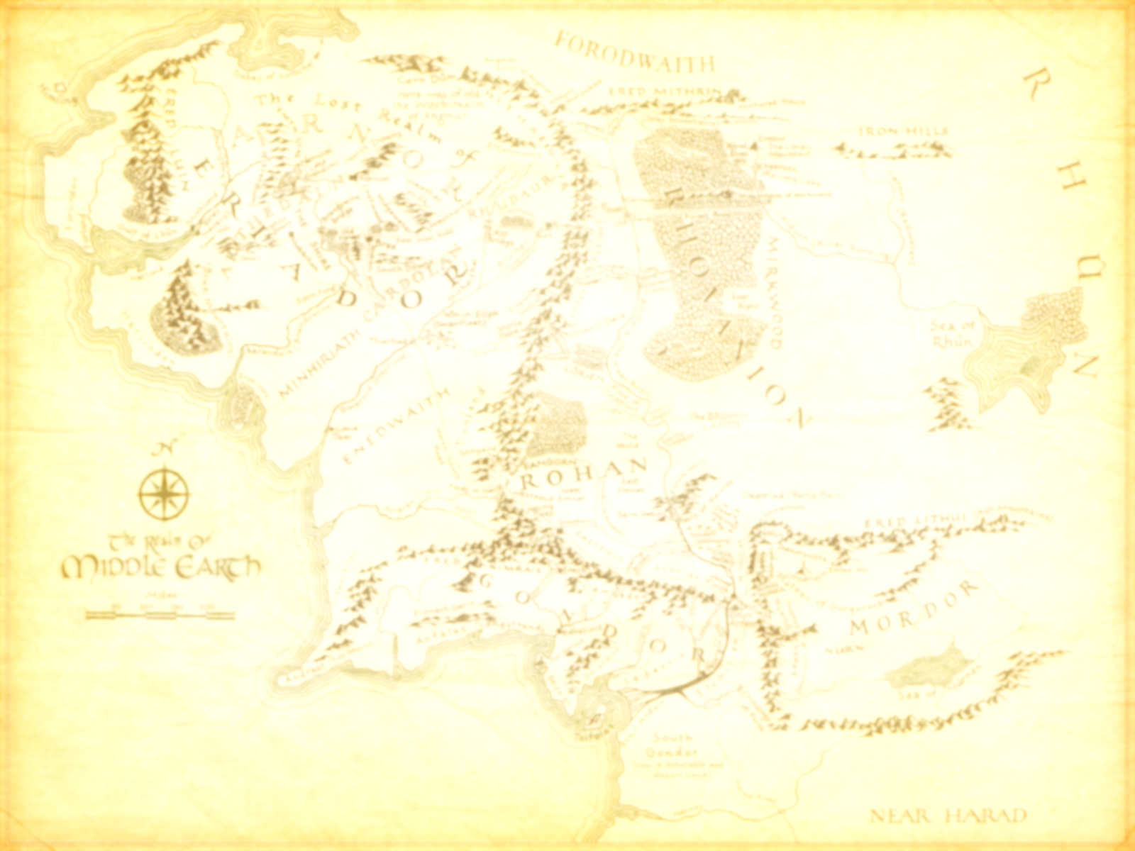
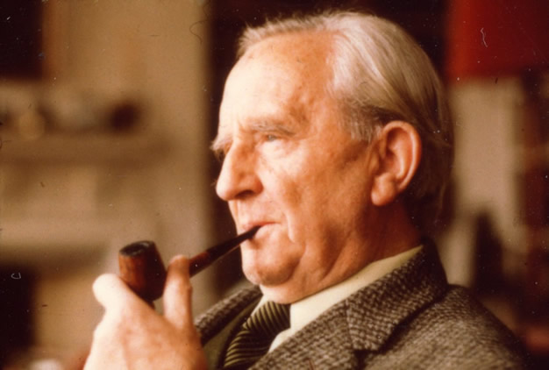
The Lord of the Rings J.R.R. Tolkien
Dr Jon Mackley
Jon.mackley@Northampton.ac.uk

Slide 2
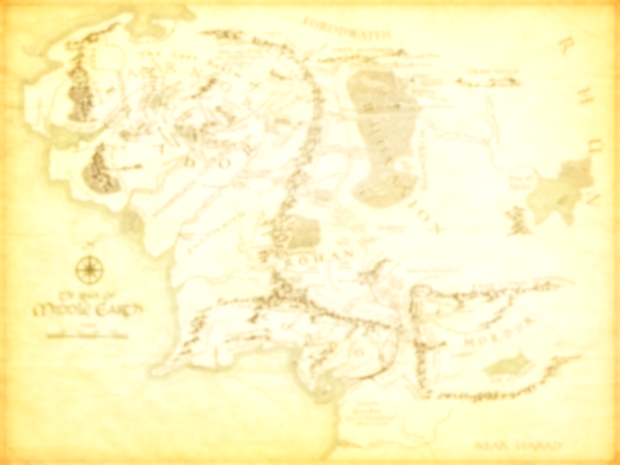
Today’s session
Discussion of Tolkien’s life and the origins of Middle Earth
Student-led presentations and discussions on ideas and themes engaged in Tolkien’s world:

Slide 4
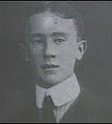
JRR Tolkien (known as Ronald) was born 3 January 1892 in Bloemfontein, S Africa. His father, a banker, was working in the Bloemfontein office of the bank.
Aged 3, Tolkien came to the UK to stay with his family, however, his father died, and Tolkien’s mother settled in King’s Heath Birmingham, permanently. She died in 1904 when Tolkien was aged 12.
Tolkien’s guardianship had been assigned to Fr Francis Morgan who brought Tolkien up as a Catholic. He went to Exeter College, Oxford initially to read classics, but later studying language and literature.

Slide 5
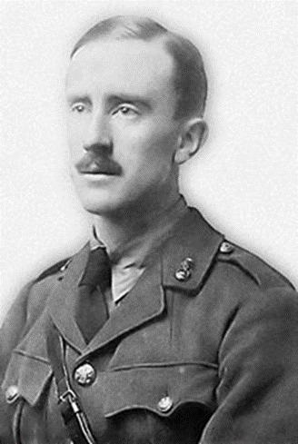
When he was 16 Tolkien met Edith Bratt, three years his senior; Fr Morgan prohibited Tolkien from communicating with Edith until he was 21. On his 21st birthday, Tolkien wrote to Edith again, and, broke off her engagement to another man and agreed to marry Tolkien.
In 1914, Tolkien chose not to enlist immediately that the war broke out, but delayed until he had completed his studies in June 1915. He served as a signals officer at the Battle of the Somme. He was invalided in November 1916 although many of his closest friends were killed.
In September 1914, Tolkien began writing the first recognisable part of the background to Middle Earth known as 'The Voyage of Éarendel the Evening Star'.
Tolkien argues that Lord of the Rings is ‘neither allegorical nor topical … the real war does not resemble the legendary war in its process or its conclusion’.

Slide 6
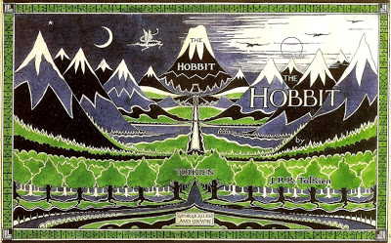
Tolkien’s post-war academic career included his work on the Oxford English Dictionary and in 1920 he became a Reader in English at the University of Leeds, then in 1925 he became Professor of Anglo-Saxon at Pembroke College, Oxford. He renewed interested in Anglo-Saxon texts, for example with his lecture: ‘Beowulf: The Monsters and the Critics’. During this time he also completed his work on The Hobbit which was published in 1936.
Rayner Unwin aged 6 read and critiqued the Hobbit;
Tolkien paid Christopher sixpence for pointing out continuity problems

Slide 7
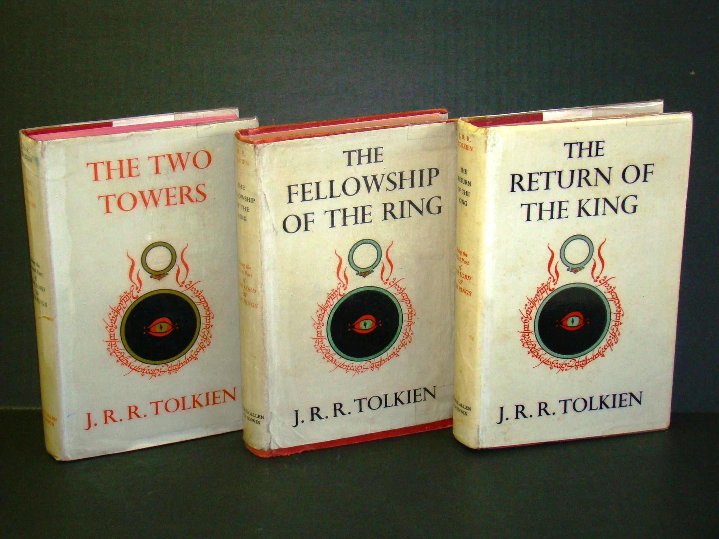
Tolkien was invited to be a code-breaker during the Second World War, but declined.
He became the Merton College Professor of English Language and Literature in 1945 (remaining there until he retired in 1959) and completed the Lord of the Rings in 1948. Sections of it were posted to his son, Christopher, who was a pilot in the RAF.

Slide 8
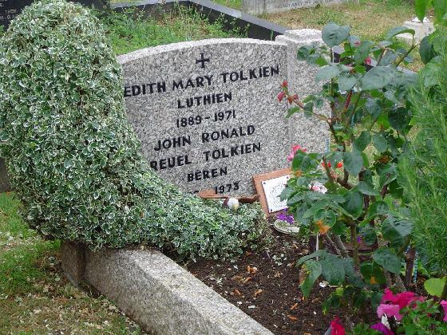
Lord of the Rings was published in Six-monthly intervals in 1954 and 1955; Tolkien gradually received more literary attention; initially he wished he had taken early retirement, although he grew more and more uncomfortable with his status as cult figure. Edith Tolkien died in 1971 and Tolkien himself two years later.

Slide 9
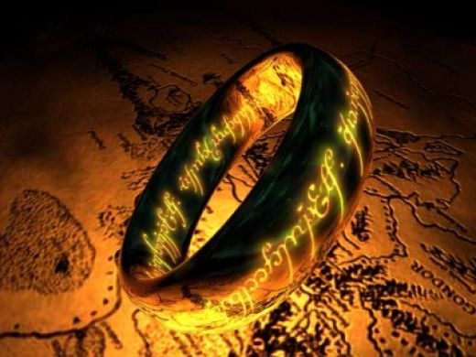
The Lord of the Rings
Tolkien had written the Hobbit for the enjoyment of his own children, but the publishers, George Allen and Unwin had felt there was sufficient interest to write a sequel.
Change in genre
Conditions of publication; costs of printing in post-war Britain; Silmarillion published in 1977

Slide 10
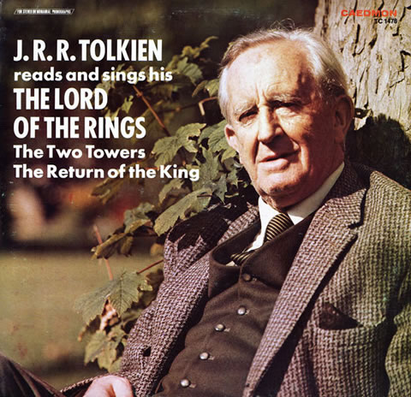
Tolkien and the Kelevala; creation of world that contained Saxon and Old Norse legends, as well as Atlantis, available for a new audience; Also Old English motif (e.g. ubi sunt, exile, riddles)
Tolkien on recording
Tolkien reads from “Riddles in the Dark”
https://www.youtube.com/watch?v=bA0OgL80msw
Christopher Tolkien Reads “Of Beren and Luthien”
https://www.youtube.com/watch?v=-L7Y1H1-pkg
Nicol Williamson performs an abridged version of The Hobbit
https://www.youtube.com/watch?v=7RXC1miPm2c

Slide 11
Völuspá (“Prophecy of the Seeress”) contained in the Old Norse Poetic Edda
10. There was Motsognir | the mightiest made Of all the dwarfs, | and Durin next; Many a likeness | of men they made, The dwarfs in the earth, | as Durin said. 11. Nyi and Nithi, | Northri and Suthri, Austri and Vestri, | Althjof, Dvalin, Nar and Nain, | Niping, Dain, Bifur, Bofur, | Bombur, Nori, An and Onar, | Ai, Mjothvitnir. 12. Vigg and Gandalf | Vindalf, Thrain, Thekk and Thorin, | Thror, Vit and Lit, Nyr and Nyrath,-- | now have I told-- Regin and Rathsvith-- | the list aright. 13. Fili, Kili, | Fundin, Nali, Hepti, Vili, | Hannar, Sviur, (Billing, Bruni, | Bildr and Buri,) Frar, Hornbori, | Fræg and Loni, Aurvang, Jari, | Eikinskjaldi.
14. The race of the dwarfs | in Dvalin's throng Down to Lofar | the list must I tell; The rocks they left, | and through wet lands They sought a home | in the fields of sand. 15. There were Draupnir | and Dolgthrasir, Hor, Haugspori, | Hlevang, Gloin, Dori, Ori, | Duf, Andvari, Skirfir, Virfir, | Skafith, Ai. 16. Alf and Yngvi, | Eikinskjaldi, Fjalar and Frosti, | Finn and Ginnar; So for all time | shall the tale be known, The list of all | the forbears of Lofar.

Slide 12
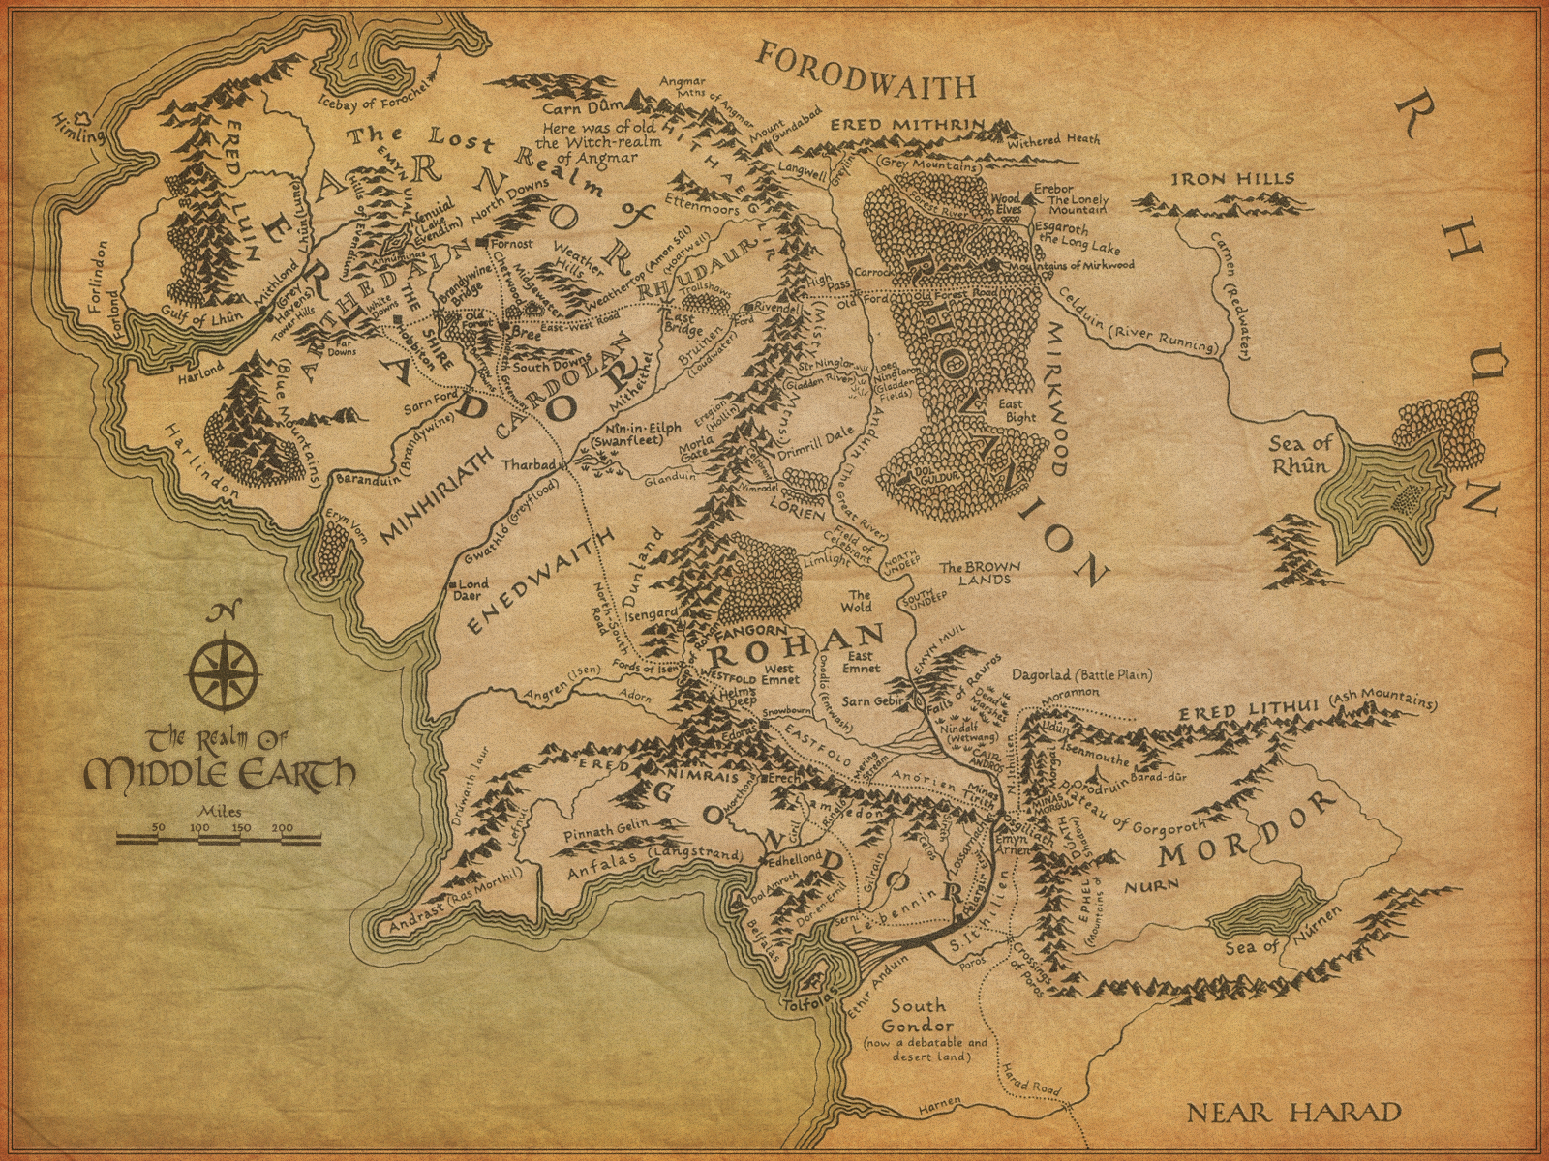
Origin of name Middle Earth; also concept that it was our world before
OE Christ:
Eala Earendel engla beorhgtast ofer middangeard monnum sended (Hail Earendel, the brightest of angels sent to the world of men)
Also in Piers Plowman – mid-point between heaven and hell

Slide 13
Farah Mendelsohn places Lord of the Rings as a portal fantasy.
Does this definition of fantasy work? Why or why not?
What other definitions of fantasy might also be appropriate?
Does Tokien’s Catholicism come through in his writing?

Slide 14
Portal quest fantasy
Shire represents pragmatism; moving away from the centre on “the quest” is, according to Mendelsohn, the portal.
Intrusive Fantasy – Gandalf/ Sauron
Immersive fantasy – perhaps THE immersive fantasy

Slide 15
Michael Moorcock
“Tolkien cannot bring himself to get close to his proles and their satanic leaders – if Sauron and co are quite as evil as we’re told. After all, anyone who hates hobbits can’t be all bad”
Also his misogynistic approach and flowery writing

Slide 16
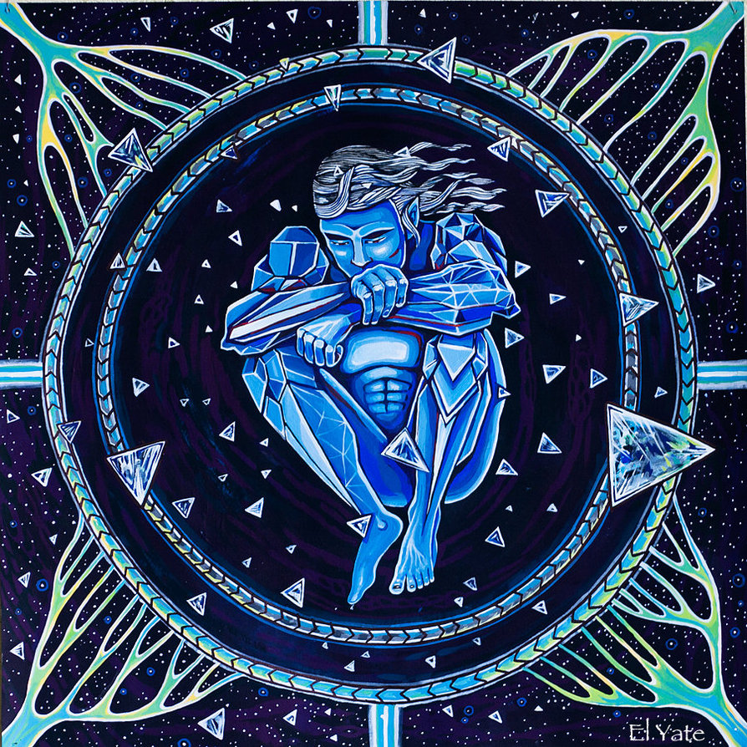
Tolkien’s creation myth
The Valarian Age (Genesis) Events that precede the First Age
The All-father (Eru Ilúvatar) brings things into creation with themes sung by the Ainur in the chorus of creation. The Ainur are divided into two classes: the Greater Valar and the lesser Maiar
Melkor was the most powerful of the Ainur, but turned to darkness and became Morgoth, from whom all evil in the world of Middle-earth ultimately stems. Sauron, one of the Maiar, betrayed his kind and became Morgoth's principal lieutenant.
Melkor was too proud to admit that his creations were simply discoveries wholly made possible by, and therefore “belonging” to, Eru. Instead, Melkor aspired to the level of Eru, the true Creator of all possibilities.

Slide 17
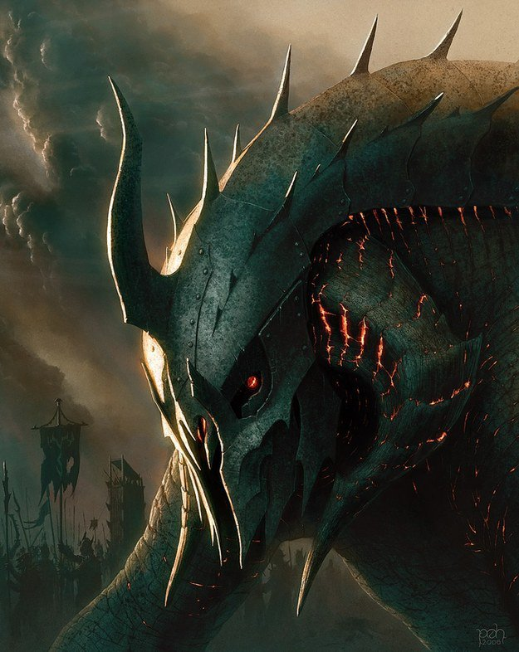
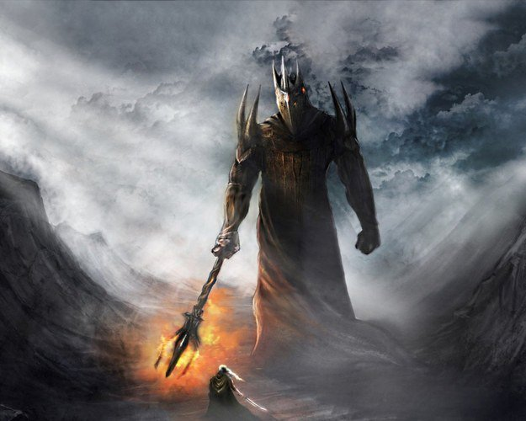
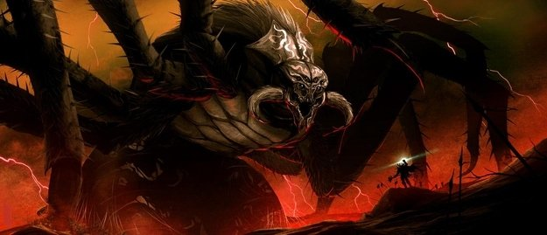
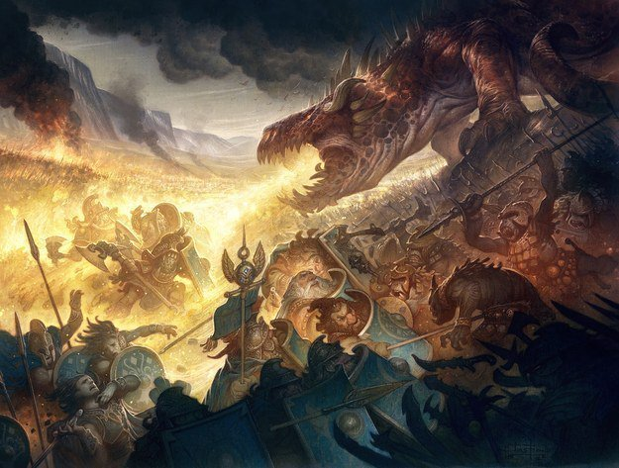
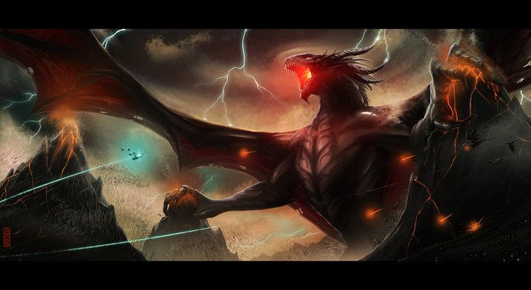
Some really bad villains
http://www.tickld.com/x/jaw/5-tolkien-villains-too-intense-for-the-big-screen?utm_content=inf_10_93_2&utm_source=tickld&utm_medium=facebook&utm_campaign=contentse&tse_id=INF_d459b31b60484dd18de3215144252cb4

Slide 18
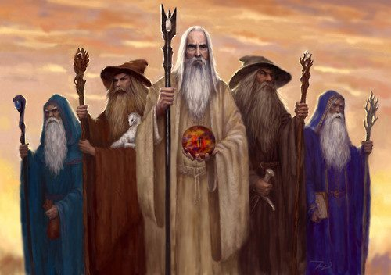
The Maiar and Istari
In the Third Age (around 1100), the Valar sent several Maiar to Middle-earth to help contest the evil of Sauron. Their mission was to guide elves and men by gaining trust and spreading knowledge, not by ruling them with fear and force. They were known as the Istari, or Wizards, and included Gandalf the Grey, Saruman the White, Radagast the Brown, and Alatar and Pallando the two Blue Wizards.
Other Maiar spirits may include Tom Bombadil and Goldberry

Slide 19
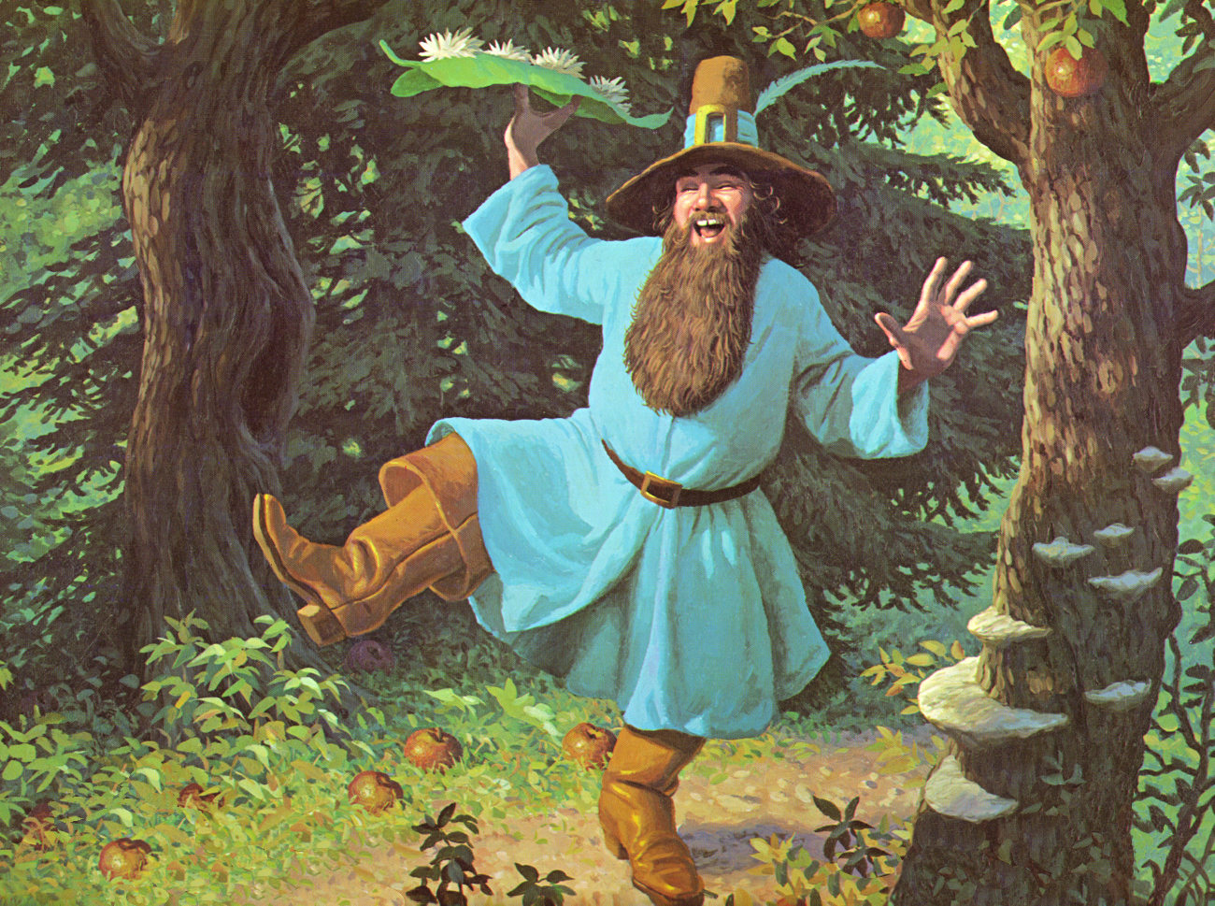
Tom Bombadil
"Old Tom Bombadil is a merry fellow;
Bright blue his jacket is, and his boots are yellow."
Why do they keep leaving him out?
Student discussion/ presentation

Slide 20
Tolkien said he had intentionally left Tom as something of an enigma. He does not fit with any of the other races. Tom could be a 'spirit of nature'. Goldberry describes him as Master of Wood, water and hill.
Elrond describes him as “Oldest” and “Fatherless”; Bombadil also says this: 'Eldest, that's what I am... Tom remembers the first raindrop and the first acorn... He knew the dark under the stars when it was fearless - before the Dark Lord came from Outside.'
Could he be a Maiar? Other Maiar are affected by the ring, but 'Tom put the Ring round the end of his little finger and held it up to the candlelight... There was no sign of Tom disappearing!'
There are even suggestions that Tom is Ilúvatar himself; he is called 'Master', and 'Eldest', and Goldberry says of him simply: 'He is.'
But Tolkien makes it clear that Tom and Eru should not be confused and says ‘There is no embodiment of the One, of God, who indeed remains remote, outside the World, and only directly accessible to the Valar or Rulers.’

