Slide 1
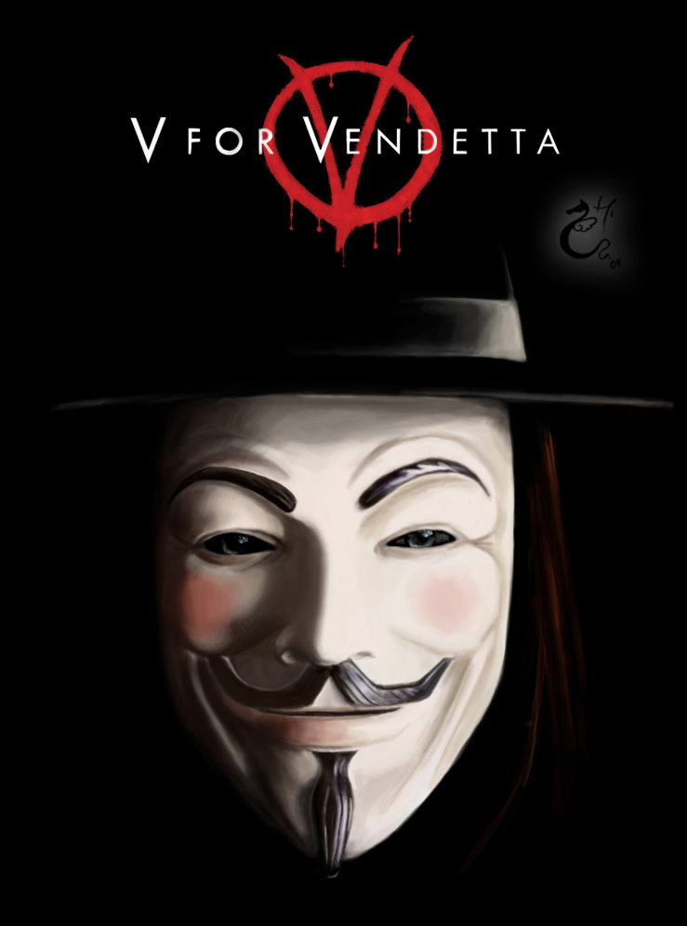
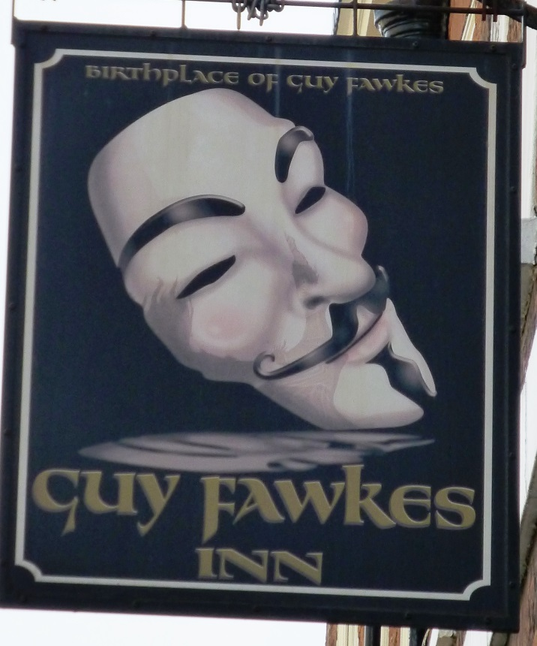
Alternative London
V for Vendetta

Slide 2
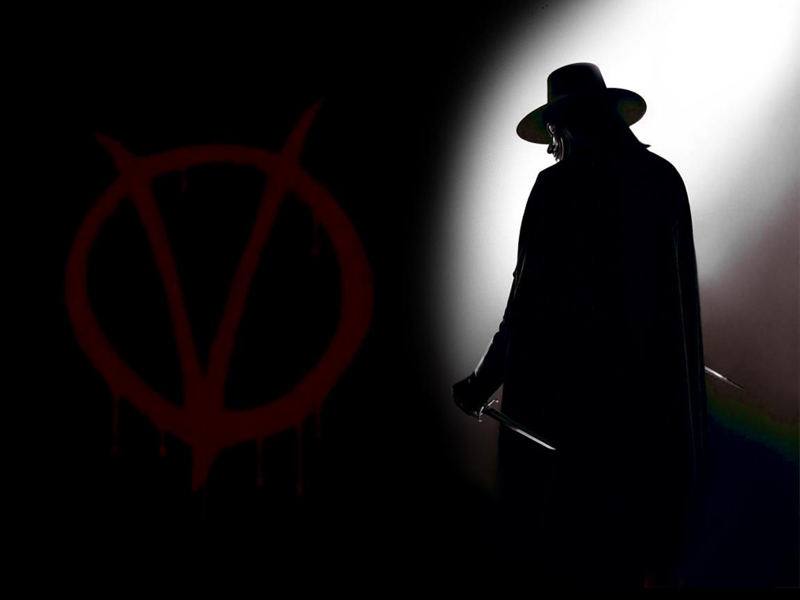
Today’s session
A Discussion of V for Vendetta as an image of dystopian London
Student Presentation
Alan Moore
Overview of text
Discussion of scene 1 (comparison with movie)
Totalitarian regimes and dystopian novels
Adam Susan and Patriotism
Representation of the Church
Memories of Larkhill
V’s Vendetta
The ending

Slide 3
vi veri veniversum vivus vici
England prevails!

Slide 4
By the power of truth, while living, I have conquered the universe
England prevails!

Slide 5
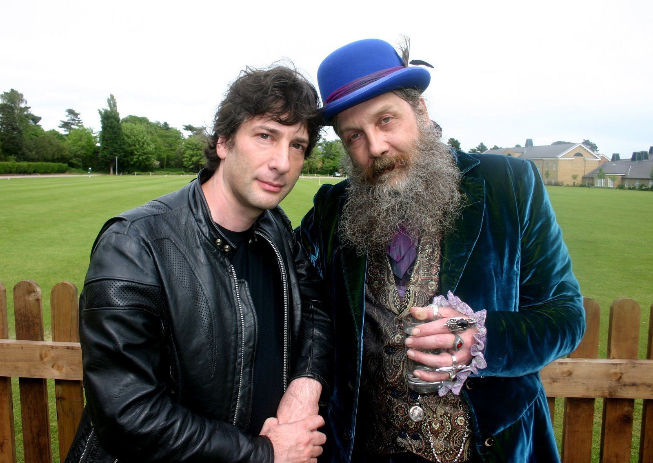
Alan Moore (born 18 November 1953)

Slide 6
Alan Moore (born 18 November 1953)
Writer and graphic novelist. He describes himself as a Neo pagan, ceremonial magician, wizard, vegetarian and anarchist. As a child he achieved a place at Northampton Grammar School, but soon realised that he was among better-educated middle class people and felt he had nothing in common with them. Consequently, he had no interest in studying and was eventually expelled for dealing LSD.
Very publicity shy. Lives in Northampton and doesn’t travel much.

Slide 7
Moore’s best know works include:
From Hell
The League of Extraordinary Gentlemen
Watchmen
V for Vendetta
Objects to the Hollywood adaptations of his films to the extent that he has his name removed from works to which he no longer owns the rights

Slide 8
V FOR VENDETTA
Originally a 10 issue graphic novel series by Alan Moore and illustrated by David Lloyd.
V for Vendetta presents a vision of dystopian England. The series is set in around 1997-98, after a nuclear war. A fascist party called Norsefire (National Front?) has exterminated its opponents in Concentration Camps.
How might this correspond with your studies on other modules?
"Strength Through Purity, Purity Through Faith"

Slide 9
Plot Summary (Book 1)
Set in 1997 – camera Big Brother style ‘for your protection’, Evey Hammond is desperate and turns to prostitution although the first person she approaches turns out to be a government “fingerman”. She is rescued by “V” to leads her to view the Houses of Parliament as it is destroyed.
Party leader, Adam Susan, orders an investigation to find him. In the meantime, V takes Evey to his home, ‘The Shadow Gallery’ – here V and Evey give a background to the dystopia – recession and the nuclear war.
V begins his vendetta, first tormenting Prothero to insanity which reveals that V was at Larkhill 1993 a ‘resettlement camp’ and is identified as ‘the man from room V’.
V’s next target is the hypocritical Bishop Lilliman. Evey acts as a means for V to get into his rooms although she hadn’t realised that V wanted to kill him.
The final target is Delia Surridge, doctor at Larkhill. Her diary gives the background to the events at Larkhill

Slide 10
Plot Summary (Book 2)
V launches an attack on the local TV station, broadcasting his own message. When the police arrive it is believed that V is killed in the attack. In fact he dressed the station manager, Roger Dascombe, to look like him.
Evey is abandoned by V and stays with Gordon, a petty criminal, becoming his lover until he is killed by Alistair Harper. While planning her revenge on Harper, Evey is captured and imprisoned; her head is shaved and she is tortures. She takes comfort from a message written by a former prisoner. However, she refuses to give up V, preferring death to betrayal. Thus, she finds that V is the instigator of the interrogation and his aim was to release her from her fear.

Slide 11
Plot Summary (Book 3)
V starts his finale with a bomb in the Jordan Tower and the Old Post Office Tower, first to cripple the Government Secret Police and then to broadcast his own message. With the Government incapacitated, civilisation descends into chaos. V then shows Evey her inheritance.
Adam Susan is assassinated, while V is mortally wounded; instead Evey assumes the mantel of V and rallies the population. She then gives V his Viking funeral in an underground train packed with ‘gelignite and lillies’ which explodes as it reaches its destination: Downing Street.

Slide 12
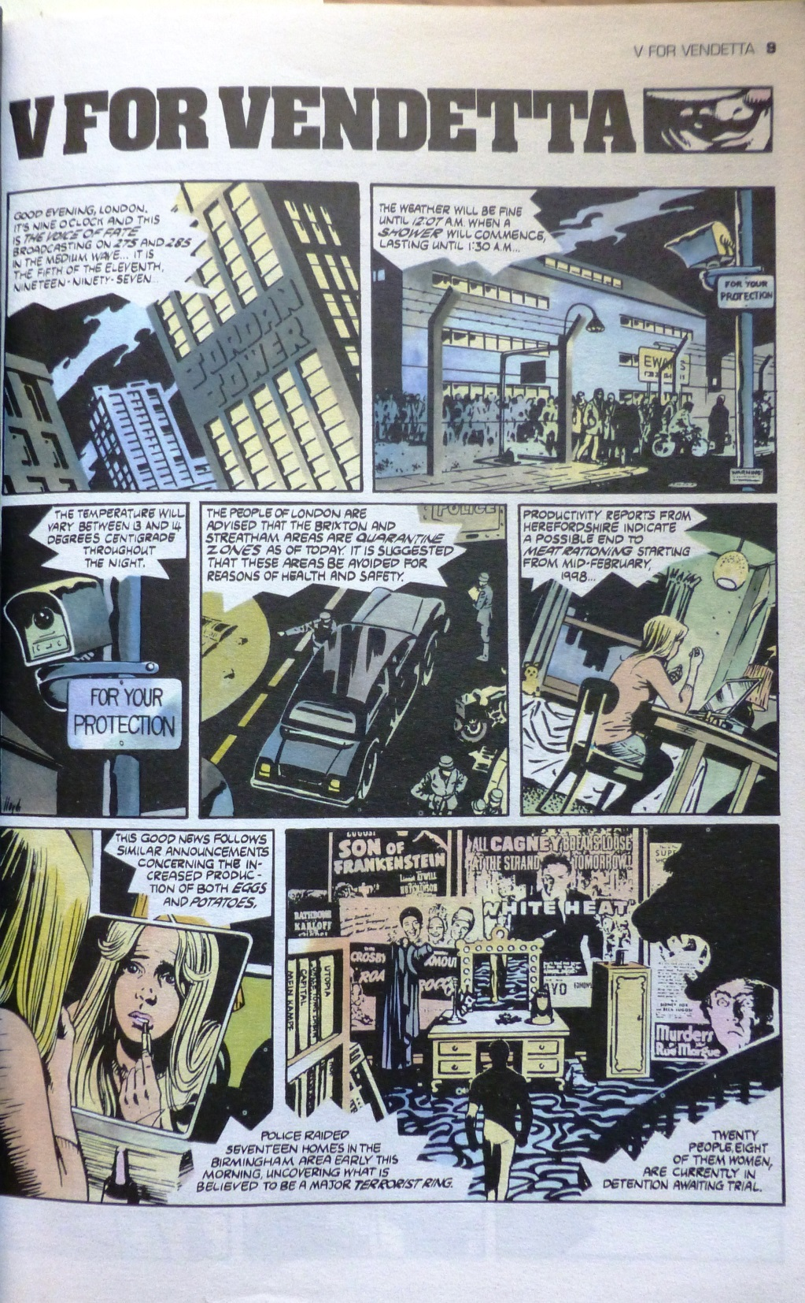
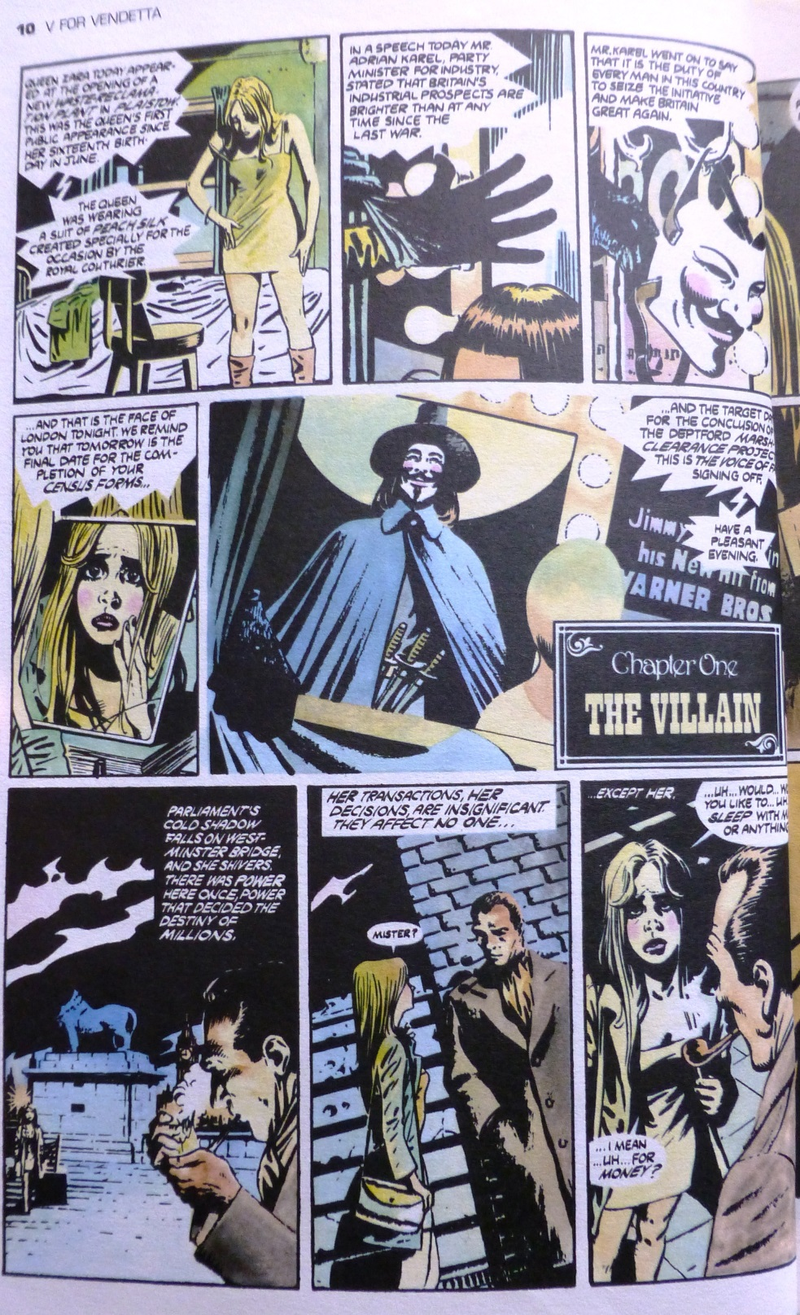

Slide 13
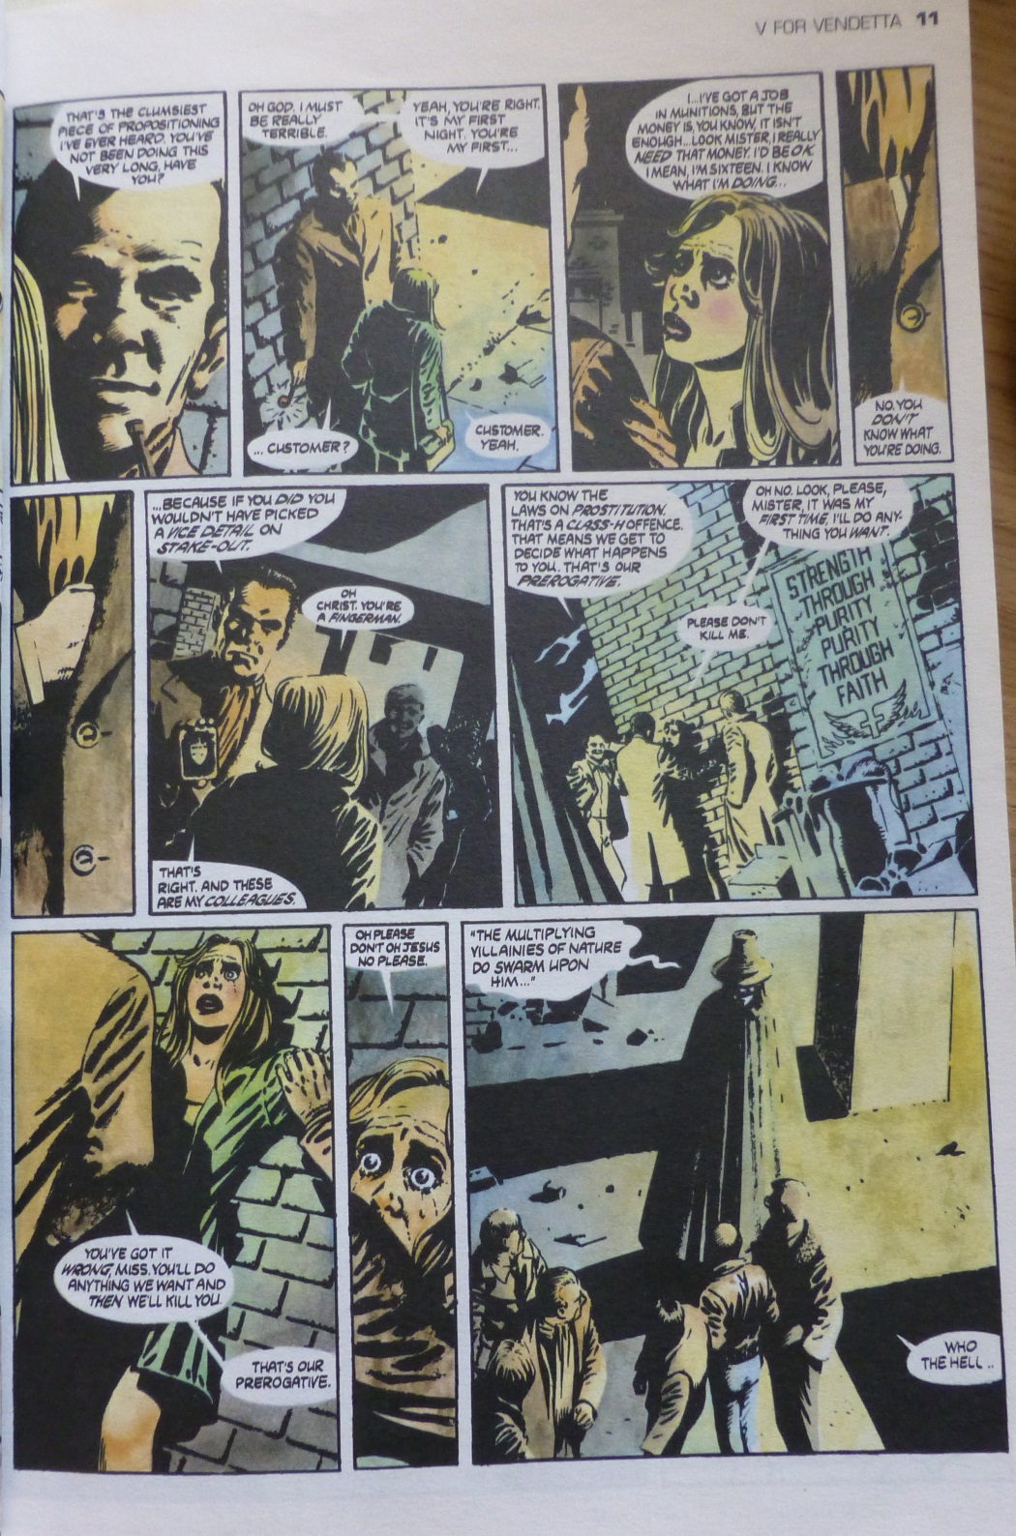
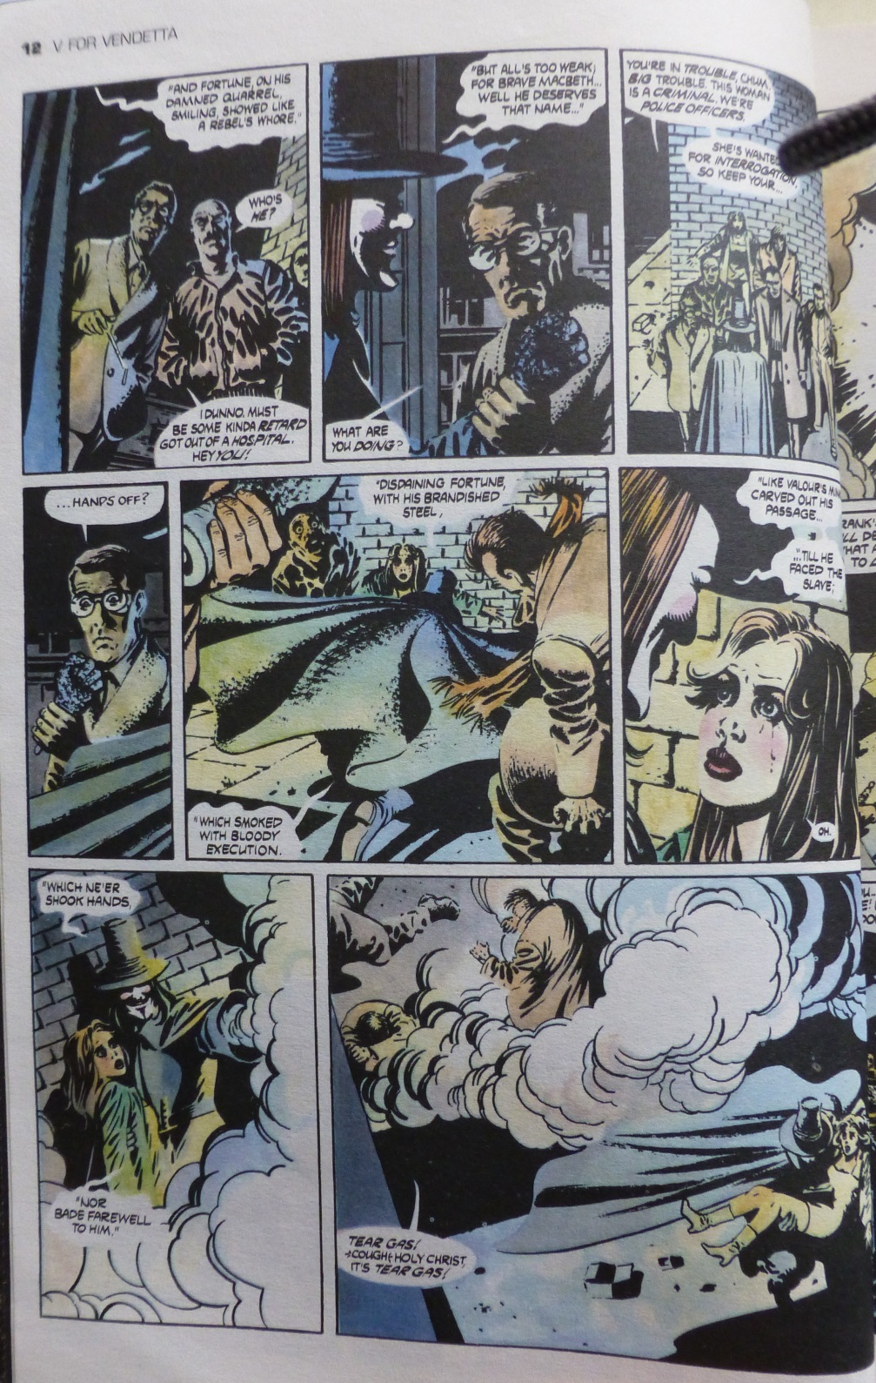

Slide 14
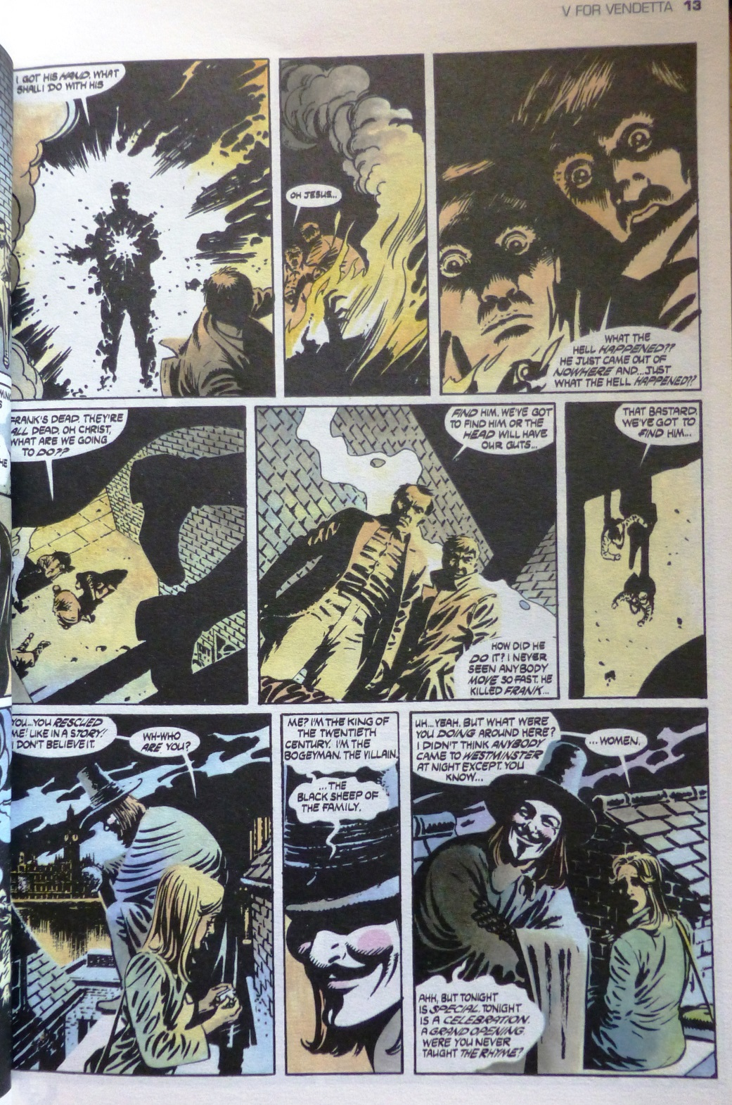
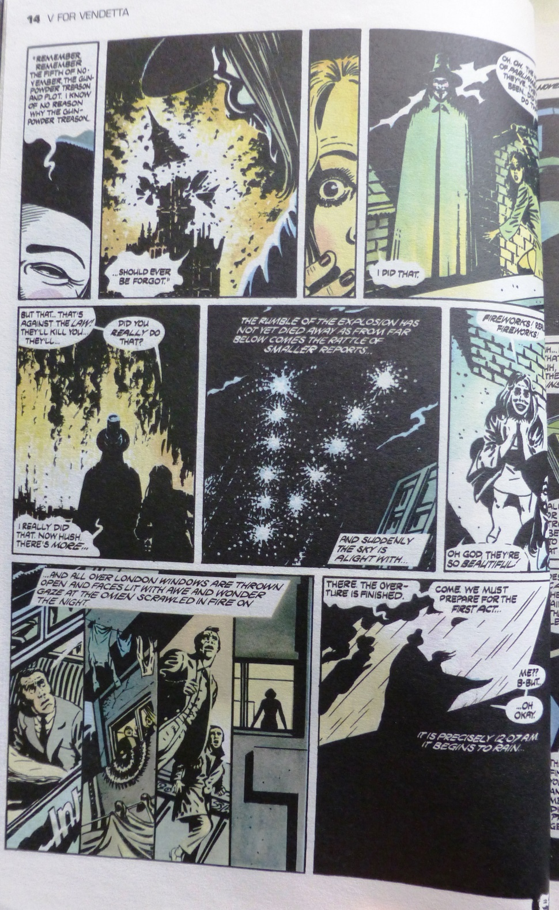

Slide 15
Compare the section from the graphic novel to the opening section of the film @2.30 mins – 10.46 mins

Slide 16
The Totalitarian Regime
The imagery of the dystopian world follows the iconography of Nazi Germany along with George Orwell’s 1984; however, when the story is set is during the time when Britain was suffering a recession under the Conservative government, led by Margaret Thatcher.
“[The movie] has been "turned into a Bush-era parable by people too timid to set a political satire in their own country.... It's a thwarted and frustrated and largely impotent American liberal fantasy of someone with American liberal values standing up against a state run by neoconservatives — which is not what the comic V for Vendetta was about. It was about fascism, it was about anarchy, it was about England”
Alan Moore, ‘Alan Moore: The Last Angry Man’, MTV 2006

Slide 17
Dystopian literatures?
Is what Alan Moore says a fair assessment of the Bush-era politics?
Can we see parallels with other dystopian literatures?

Slide 18
Dystopian literatures?
It was always at night--the arrests invariably happened at night. The sudden jerk out of sleep, the rough hand shaking your shoulder, the lights glaring in your eyes, the ring of hard faces round the bed. In the vast majority of cases there was no trial, no report of the arrest. People simply disappeared, always during the night. Your name was removed from the registers, every record of everything you had ever done was wiped out, your one-time existence was denied and then forgotten. You were abolished, annihilated: VAPORIZED was the usual word.

Slide 19
Dystopian literatures?
In the mid-1980s near Boston, Mass., a cabal of rightwing fundamentalists murders the U.S. President and members of Congress, disenfranchises women by impounding their credit cards and denying them jobs and education, and sets up Gilead, a repressively conservative state bent on annihilating homosexuals, abortionists, and religious sects other than their own, and resettling Jews, old women, and non-white people in radioactive territory, known as the Colonies. Because nuclear and biological warfare has polluted vast areas, the population suffers a sharp decline in viable births and a rise in birth defects. Consequently, infertile and aged females, as well as homosexuals, are dispatched as clean-up crews in the Colonies. Fertile women involved in illicit liaisons or second marriages are apprehended, indoctrinated, and parcelled out to Commanders of the secret police as Handmaids.

Slide 20
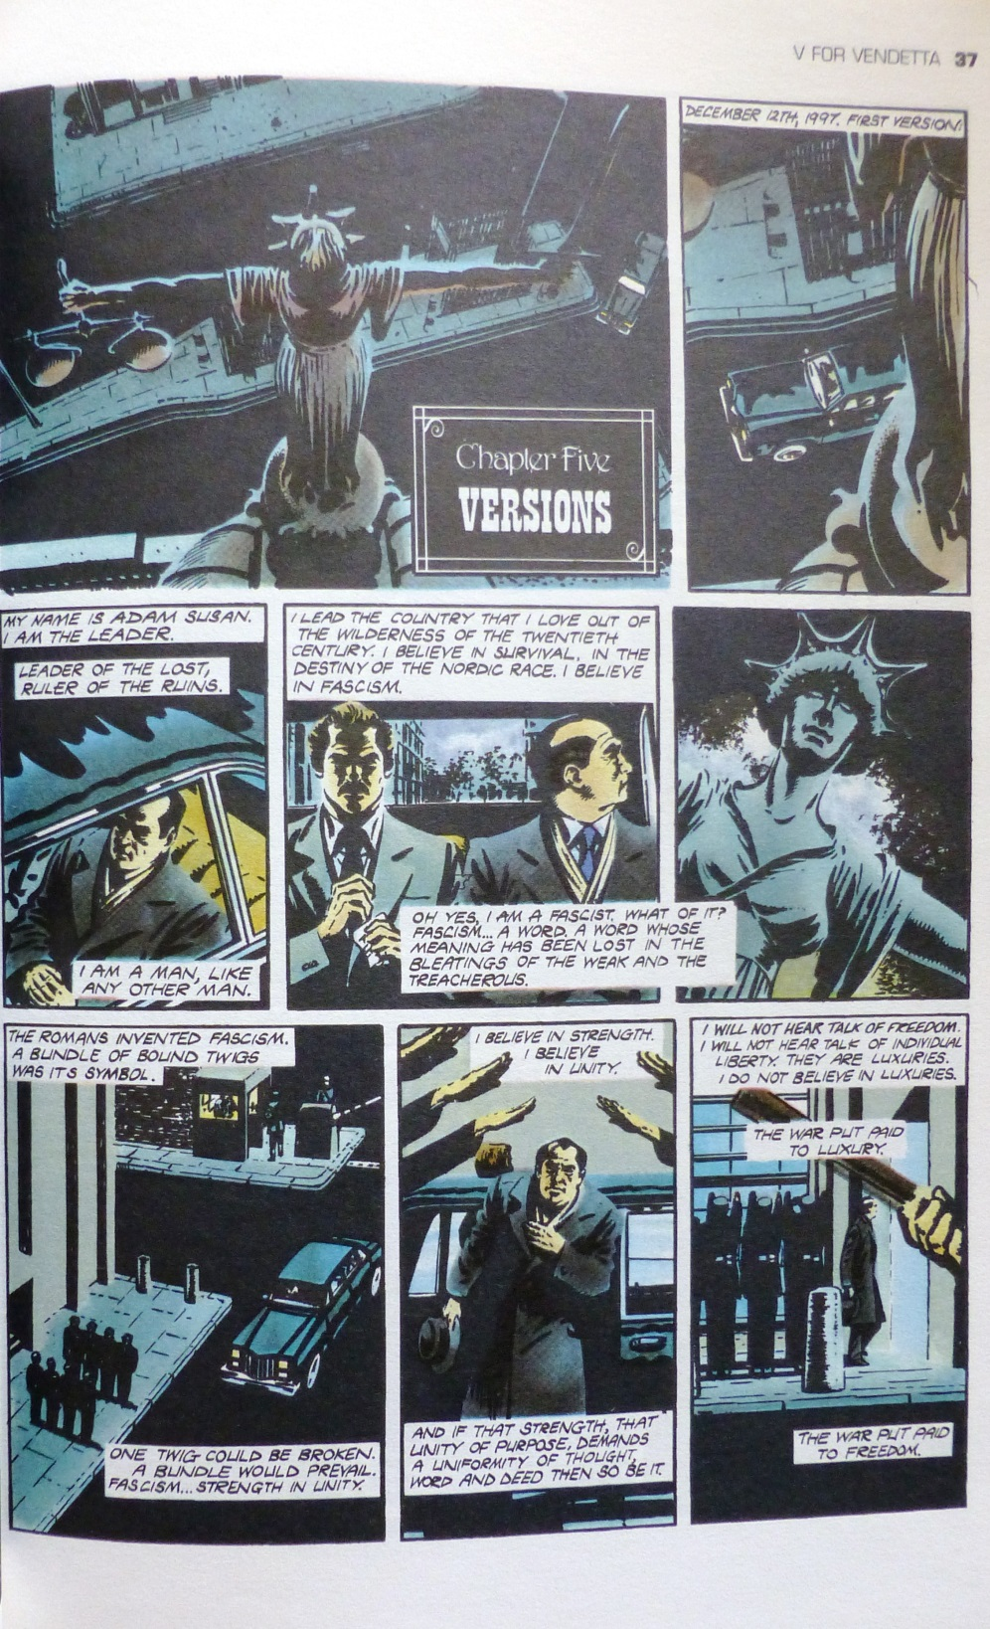
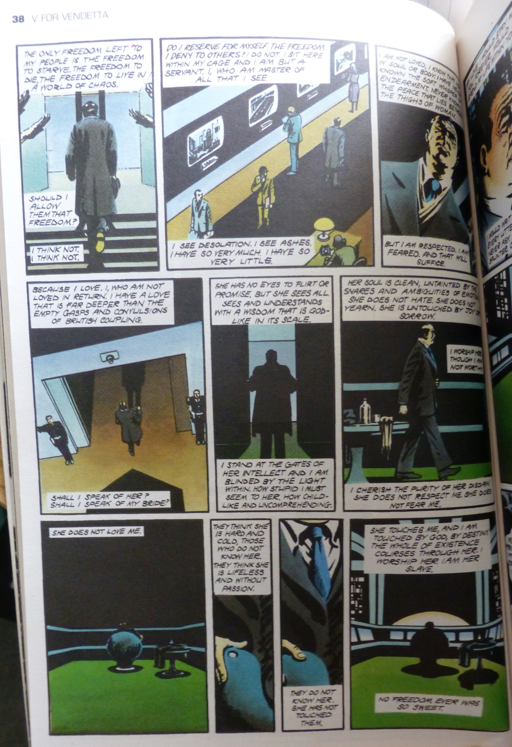

Slide 21
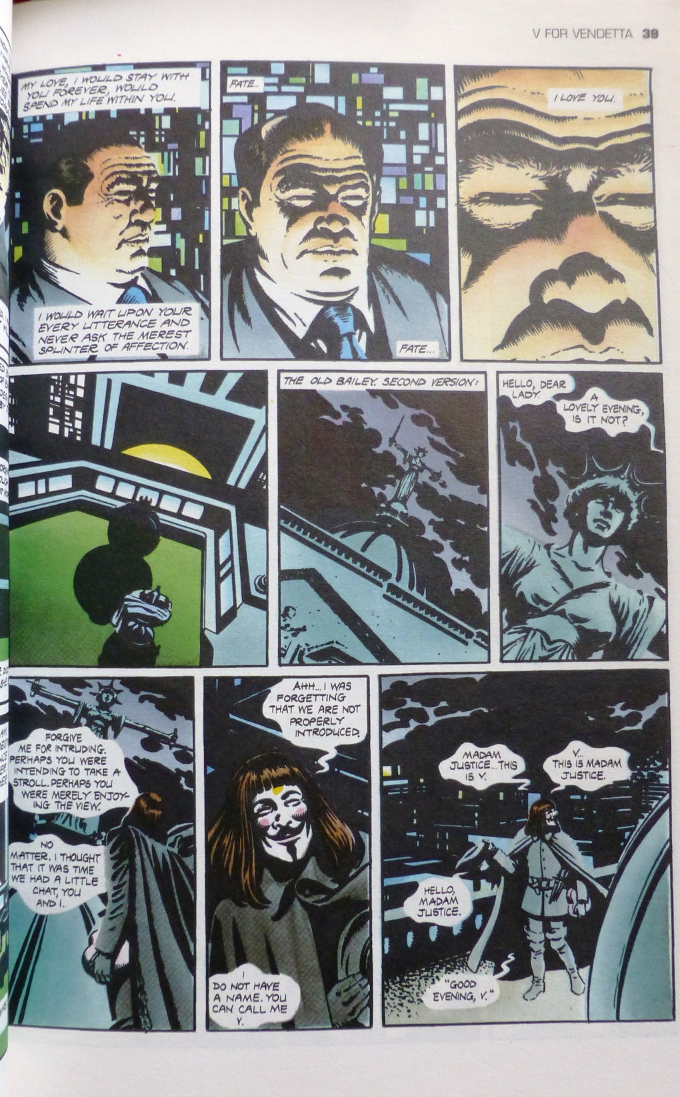
The New Statesman (1987-1992)
https://www.facebook.com/watch/?v=702809196773593
“I lead the country that I love out of the wilderness of the twentieth century” p. 37-39
How do we feel about Adam Susan’s version of “patriotism”?
How does this compare with current feelings on Brexit?

Slide 22
Xenophobia, racism, prejudice.
V for Vendetta holds up these traits and reveals what would happen if intolerances were allowed to be expressed by powerful people (again).
“Good guys win. Bad guys lose. And, as always, England prevails”

Slide 23
One might argue that the world of V for Vendetta is a parallel world to our own, but while the framework is ‘imaginative’ there is nothing magical or supernatural about it – it is entirely plausible.
There is also a reasonable explanation for V’s inhuman strength – Josef Mengele-style experimentation in the Concentration Camps

Slide 24
How does V for Vendetta conform to any of the theories of the fantastic that we’ve looked at?

Slide 25
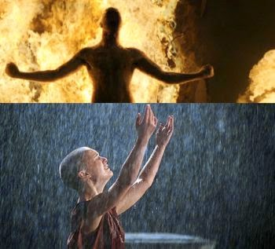
“Remember the idea, not the man. The man can still be killed or forgotten. An idea can still change the world”
V talks about the destruction of symbols. How important is this to the narrative. Is V more than a symbol?
Joel Silver sees V as a superhero, David Lloyd and James McTeigue see him as a masked vigilante. What is he? How do the different ideas change V’s role?

Slide 26
“That’s very important to you, isn’t it? All that theatrical stuff” (p. 31)
Has Evey correctly identified the core of V’s character and if so, in what way?

Slide 27
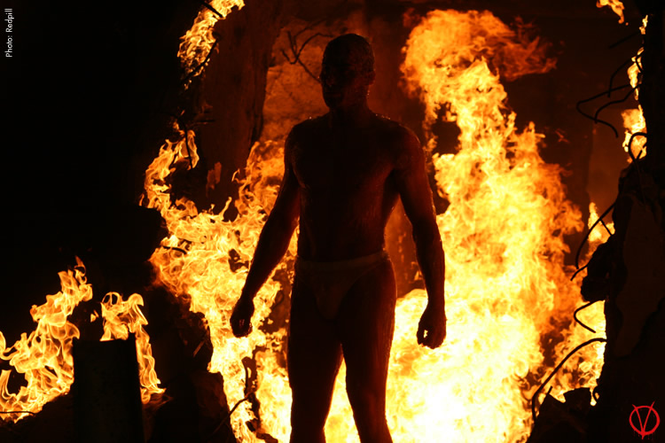
Memories of Larkhill
@55.37-57.57
Once we know about the background to Larkhill, how do we feel about V’s vendetta?

Slide 28
For V there are two parts to the protest: the overall aim is to complete his vendetta, to exact his revenge for those who operated and managed the Larkhill facility. But in the graphic novel, this is competed at the end of the first volume.
At the same time, his ambition is to motivate the people out of their apathy and fear and move against the government.

Slide 29
Anarchy wears two masks, both creator and destroyer.
Thus destroyers topple empires: make a canvas of clean rubble where creators can then build a better world.
Rubble, once achieved, makes further ruin irrelevant

Slide 30
V’s final realisation is that he is motivated by a personal vendetta, so he surrenders the destruction of Downing Street to Evey.

Slide 31
“An inch. It’s small and it’s fragile and it’s the only thing in the world worth having. We must never lose it or sell it or give it away. We must never let them take it from us.”

Slide 32
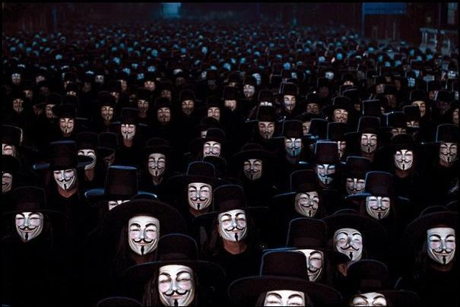
If a terrorist is someone who attacks citizens and “civilian” targets in hopes of influencing government, is V a terrorist and are his deeds terrorism?

Slide 33
If I take off that mask, something will go away forever, be diminished because whoever you are isn’t as big as the idea of you…
V destroys symbols, because of the power that they hold, but he is still a symbol himself, moreso once he is dead.
The End@1.53.39-2.00
(around 50.00-56.40 in two part version)

Slide 34
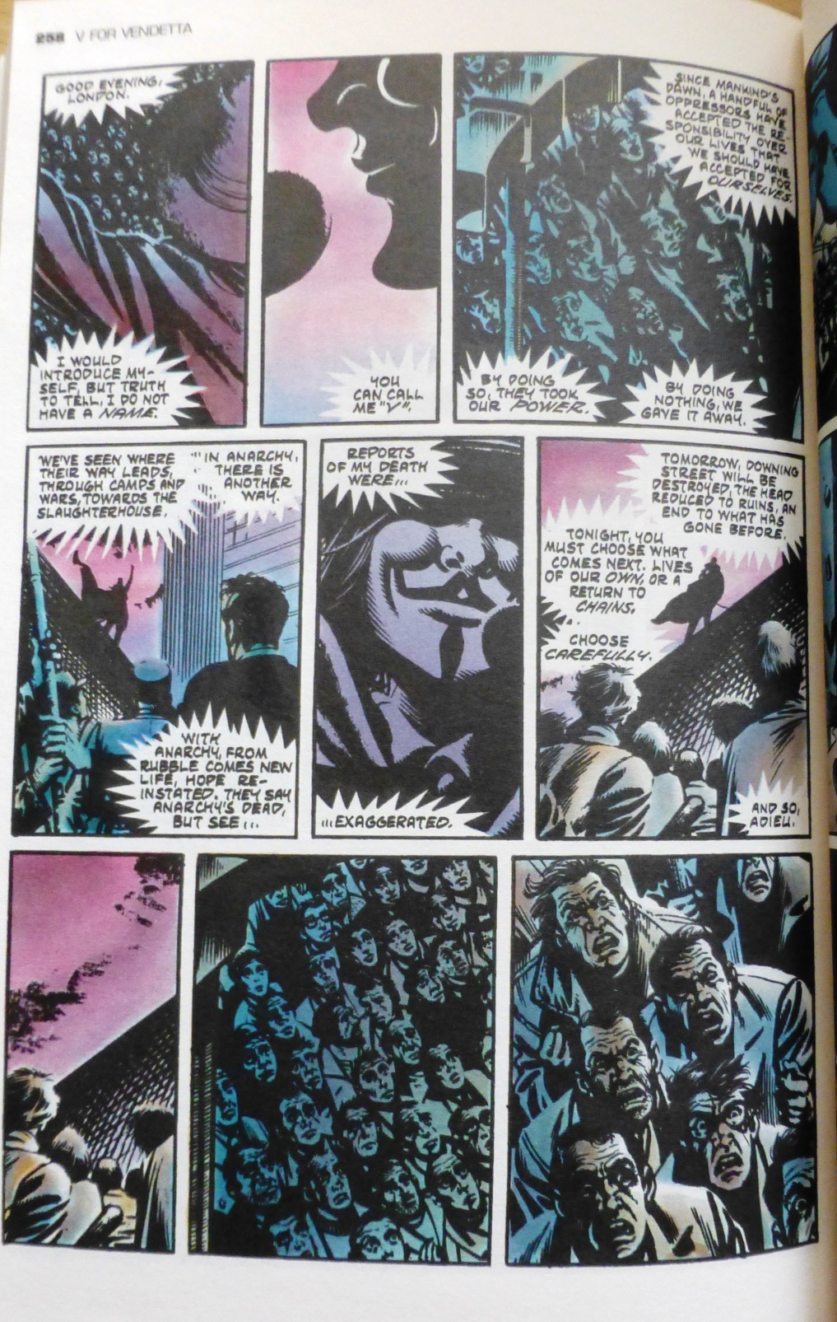
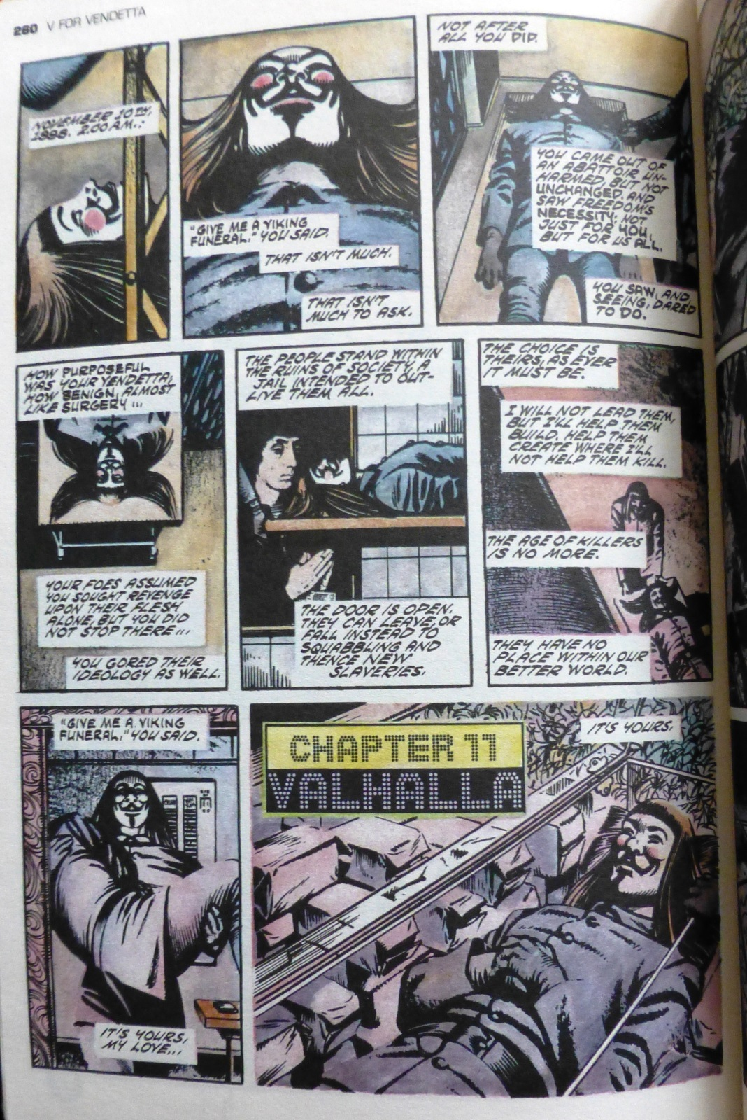

Slide 35
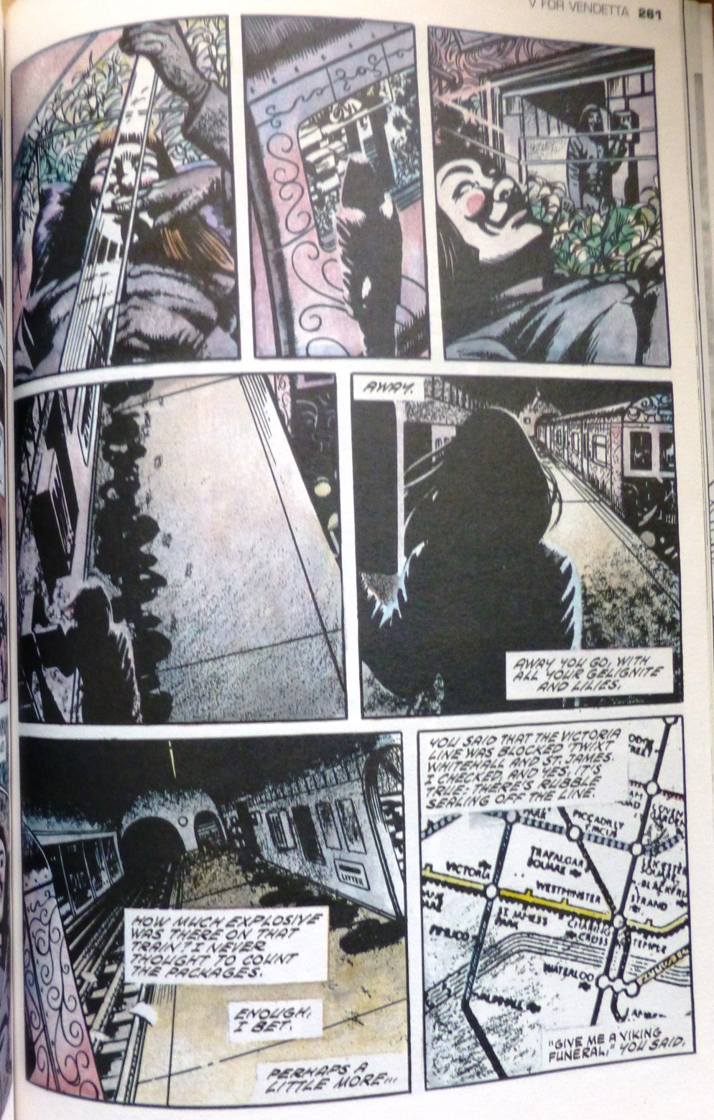
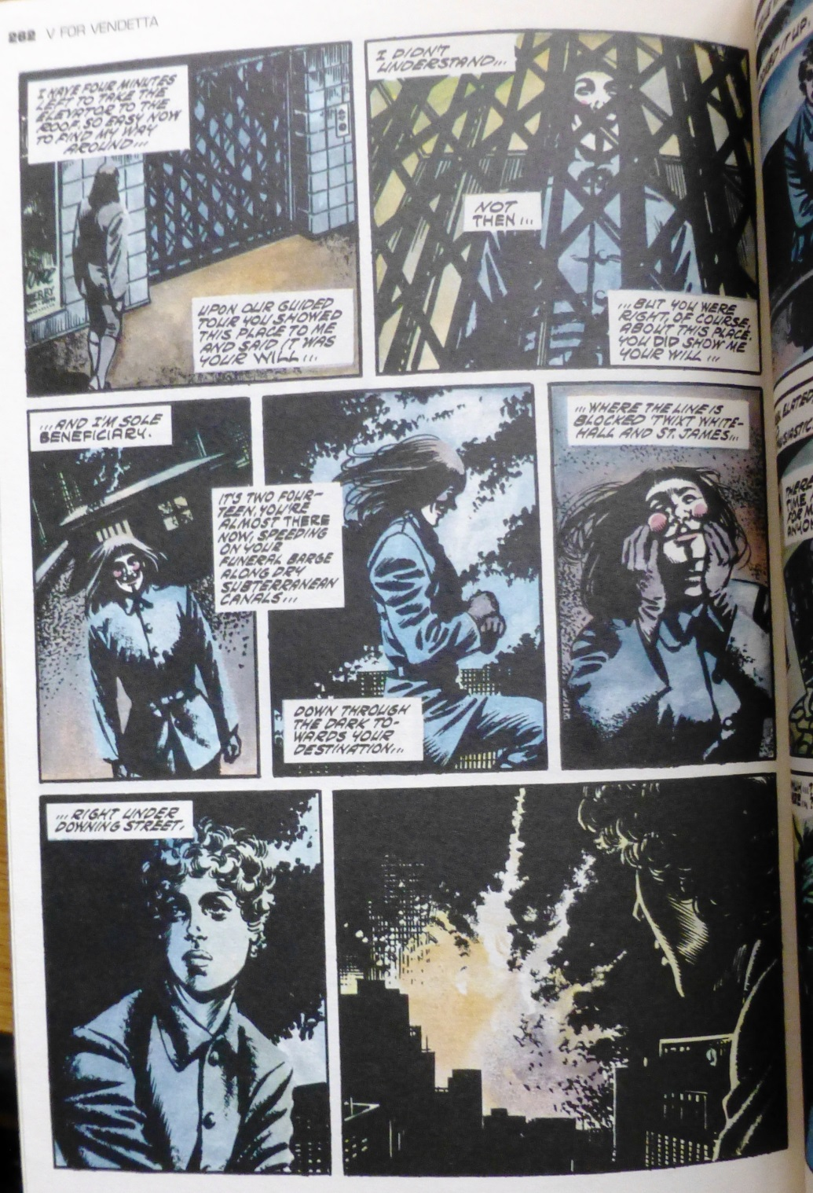

Slide 36
People should not be afraid of their Governments. Governments should be afraid of their people.

Slide 37
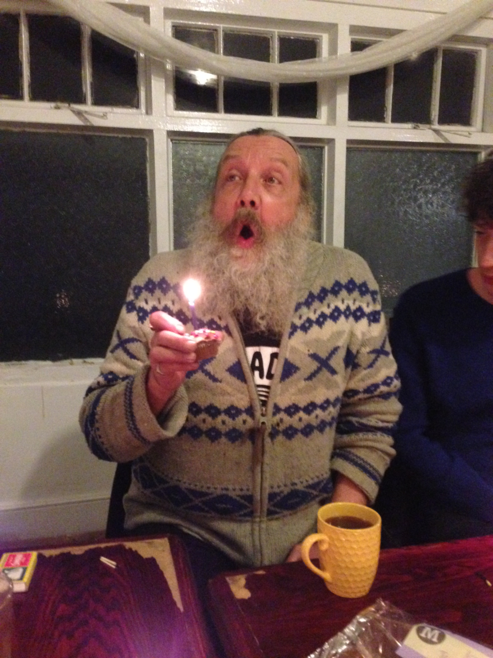

Slide 38
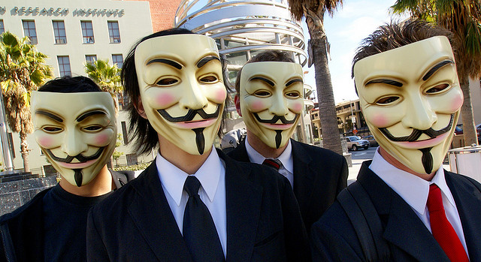

Slide 39
